Slide 1
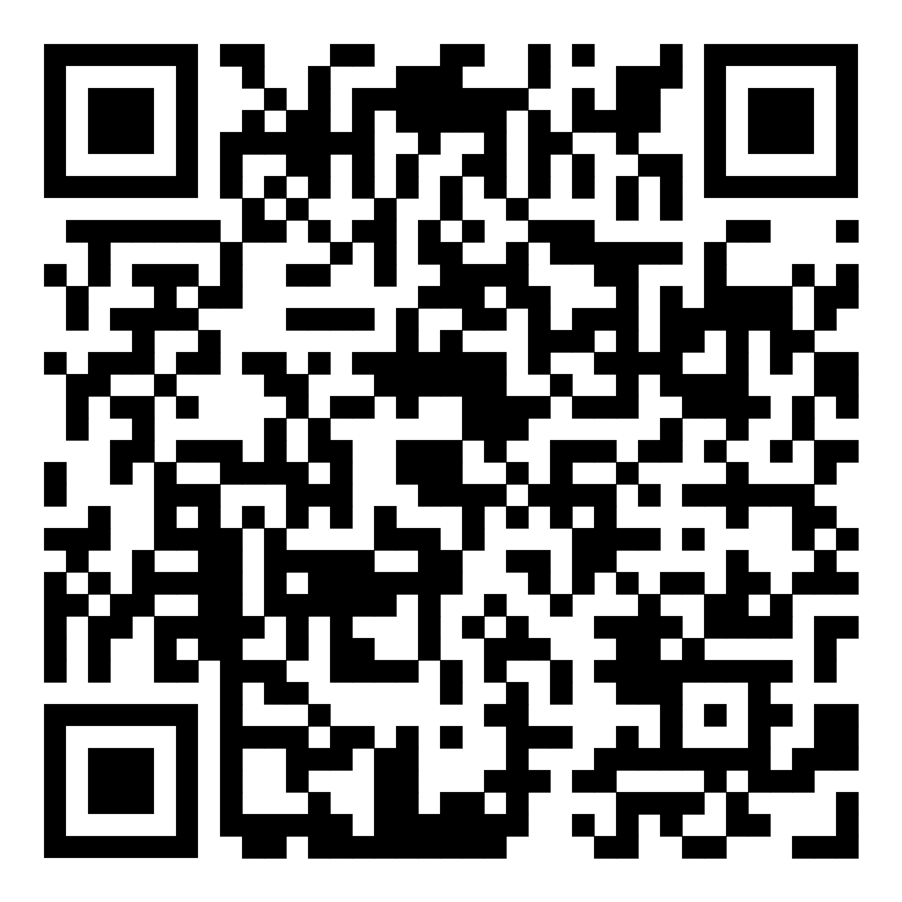
Make A Game
Exercise Slides
Download the slides.
Virtual Whiteboard for group work
Copyright Crowell Interactive Inc.

Slide 2
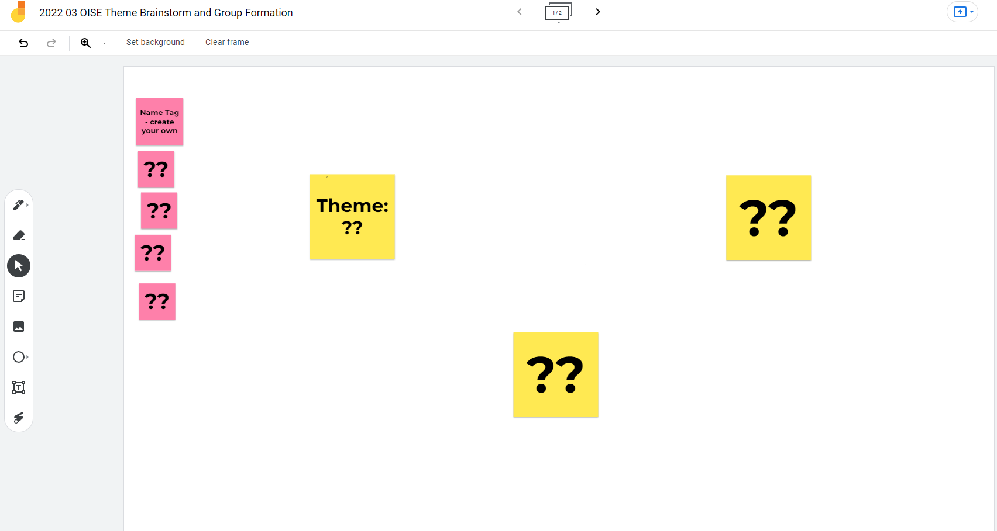
Curriculum and Teams:
Deliverable
Everyone on a team that is focused on a curriculum of their choice
Process:
* All: Brainstorm fields/curriculums of interest
You: Choose which field you want to work on
You: Sign up for the team who is working on that
You: Be ready to go to your Team sub-room in Zoom
Using Google Jamboard
Notes:
https://jamboard.google.com/d/15Whl7XowfLO5RjwffFWu1IjZ3dnLyqUS_liMVGylsfc/edit?usp=sharing

Slide 3
Educational Goals:
Curriculum, Concepts, & Outcomes
Deliverables
Decisions on:
* The Curriculum Category
* The Educational Concepts you will focus on
* The Learning Outcomes you want to achieve
Process:
* brainstorm your possible choices
* Consider the expertise you have on your team
* MAKE CHOICES THAT MATTER
NOTE: These can change as you develop your design, but choose SOMETHING for now. This is just for the Educational Goals, gameplay ideas come after this!
Curriculum Categories
Education Concepts
Outcomes and Goals
Example: Food Science
Example: Physics
Example: Can use a cookbook
Example: Follow Recipes
Example: Nutrition
Example: Understands how nutrition impacts human development
Choose ONE
Choose ONE
Choose a FEW

Slide 4
Project Constraints:
Pedagogical & Development
Deliverables:
* Clarity on the limits of what you are doing
Process: Identify what limits you need to live within for your project
NOTE: These WILL change as you develop your design, but choose SOMETHING for now
Play Experience
Level of Learning?
Level of Abstraction?
Length of Play Session?
Pedagogical Constraints
WHO will be playing this?
WHERE will this be played?
HOW does it fit into existing curriculum/framework?
Development Constraints
Expertise of team members?
Target Technology?
Time and Money available?
Example: No programmers
Example: intro level of info on subject
Example: Player is a high school student
Example: Professional Chef on team
Examples: Game is a casual intro to topic Game is a strict simulation
Example: Game is played in class
Examples:
Runs on Windows PCs Is a table top game
Example: Game is played in 20 min sessions
Example: Game is played after lecture and before reflection discussion
Examples:
Done by December 5k grant
Example: Educator does not have to play the game, just facilitate

Slide 5
Gameplay Ideas:
Scenarios, Choices, & Actions
Deliverables:
* Clarity on the game world and player role
* The kinds of Challenges the player faces
* The kinds of Choices and Actions the player can take
* Note some results from the player Choices and Actions
Process: Identify a few different concepts and evaluate them
* Ripe for game based approach: “It would be more interesting to DO than just read about it”
* Relevance (how is it important to real life?)
* Are there usable systems associated with the concept?
* Discuss real world actions that use them
* Choose: the one that teaches best + sounds fun to play
NOTE: These WILL change as you develop your design, but choose SOMETHING for now
Scenarios & Roles
Challenges & Choices
Actions & Results
Example: Player is a robot in a math based world
Example: Player role is that of a school counselor who has to deal with student issues
Example: 2 - 4 players compete to be the first to circumnavigate the world using only public transportation.
Example: Player must use Addition and Subtraction to make change in their food truck
Example: As an ER nurse the player must assess patient symptoms under time pressure
Example: Player must use Angles to plot a course through obstacles and over targets
Example: Player has 5 Action points to use during their turn.
Example: As a final piece, students write a reflection: 1) What was the hardest part of the game 2) What was the easiest part of the game? 3) What would you change? 4) Do you think the game has real-life implications?
Example: The game takes place on a grid, or is played using a deck of cards.
Example: Describe how players can pass a skill check by using the learning outcome

Slide 6
Gameplay Vision
Deliverables:
* 1 – 2 Challenge + Actions combinations that players will perform as the key gameplay
* The Gameplay Flow (do this first, then this, then this) This is a first draft of your Golden Flow
* Success and Fail conditions (1st Pass)
Process:
* Discuss Challenges that require the player to make choices based on their understanding the concepts.
* Define the Actions the player would do that use the concepts.
* Show how player choices and actions can lead to winning or losing
* Write the rules for performing, succeeding, and failing the actions.
NOTE: These WILL change as you develop your design, but choose SOMETHING for now
Scenarios and Rules
Gameplay Flow
Success and Fail
Combine the best Challenge and Action choices from the previous section
Example: Players take turns doing their actions
Example: Each Turn a player takes the following actions: 1- Move, 2 - Draw a card, 3 - resolve the card
Example: The player with the most points after 10 rounds of play is the winner
Example: If a player loses all their money they are out of the game. (Caution - may not be optimal to have the game continue with some players left on the sidelines. Think of how they could continue to play)

Slide 7
Final Game Concept
Deliverables:
A completed Concept that would allow someone else to understand the "what is it" of your game
Process:
* Summarize and document the best ideas from the previous stages
* Develop those ideas to get them to a coherent description of a game
* Use Google Docs or other tools as needed. Be sure to put a link in this board!
NOTE – creating and playtesting the prototype will almost certainly evolve the game. But it is essential to have a concept that COULD work as a starting point.
Goals
Educational Goals
How To Play
Summary of how to play the game
How to Set up the game
How to do Regular Play
Sequence of play
Actions and Rules
Examples of play
How to Win / Lose
Actions and Rules
Examples
What happens when someone wins or loses
Game Description
Game World and Player Role

Slide 8
Prototype Process

Slide 9
PROTOTYPE: Rulebook
Deliverable:
A document based off your concept that would allow someone else to understand the "what is it" and "how to play" of your game
* All the rules on how to setup and play
* List of all the game pieces
* Examples of play
Process:
* Summarize and document the best ideas from the previous stages
* Develop those ideas to get them to a coherent playable state
Copy from your Final Concept and develop it into something playable using the PROTOTYPE slides as templates
Goals
Educational Goals
How To Play
Gameplay Summary
Set up the game
Regular Play
Sequence of play
Actions and Rules
Examples of play
Win / Lose
Actions and Rules
Examples
What happens when someone wins or loses
Game Description
Game World and Player Role

Slide 10
PROTOTYPE: Golden Path
Deliverable:
An overview of the challenges the player can face, and how they progress through them
* Layout of the Golden Path
Process:
* Use the tools here or import to create an overview of the flow of the player from start to finish
* If you find your path is linear, you need to add some Choices to give the player Agency
* Update other boards as you discover game elements.
For example - you find that your game challenges need more information for the player, you update the Game Challenges on the next board.
* Use tools like Google Slides if they are easier to work with, just update this board with a screenshot if you do that.
Copy from your Final Concept and develop it into something playable using the PROTOTYPE slides as templates
Challenge
Challenge
100% SUCCESS
Challenge
Challenge
Challenge
PARTIAL SUCCESS
START
Challenge
Challenge
MIN SUCCESS
Challenge
Challenge
Challenge
FAILURE
Challenge
Challenge
Challenge
Challenge
Challenge

Slide 11
PROTOTYPE: Game Pieces
Deliverable:
Descriptions of all your game pieces
* Game board (if any)
* Cards and their content (if any)
* Other game elements
Process:
* Use the tools here or import to create art for the game pieces
* Create lists or other content as needed (what is on the cards for example).
For example - Use Google Sheets to create a numbered list of what each card would say, and use a random number generator to simulate drawing a card from a deck. https://www.google.com/search?q=random+number
Copy from your Final Concept and develop it into something playable using the PROTOTYPE slides as templates
Dice
Draw some examples of cards?
Use shapes for game tokens?
Use shapes or import art to create a game board

Slide 12
PROTOTYPE: Scratch Pad
Process:
Use this slide as a scratch pad, make more slides

Slide 13
PROTOTYPE: Scratch Pad
Process:
Use this slide as a scratch pad, make more slides

