Slide 1
WHO IS THIS GUY?
Chris Wombat Crowell
Game Design and Creative Direction since 1994
Worked At Electronic Arts, Maxis, Ubisoft, others
Now teaching Game Design at Sheridan College
And working as Crowell Interactive to assist educators like you to create awesome Game Based Learning and Educational Gamification

Slide 2
WHO IS THIS GUY?
Adam Clare
Lead Designer - Wero Creative
Clients include Microsoft, Sage, and EY
Escape room guru, author of ‘Escape the Game’
Veteran educator, currently teaching Game Design at Sheridan College

Slide 3
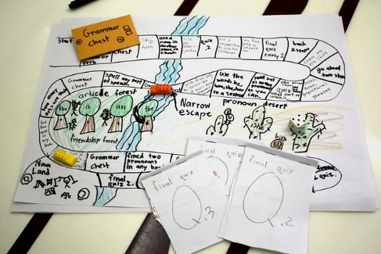
WELCOME TO THE “LET’S MAKE A GAME” WORKSHOP
3 HR. VERSION
FACILITATED BY CHRIS ‘WOMBAT’ CROWELL & ADAM CLARE
PERFORMED BY ‘YOU’

Slide 4
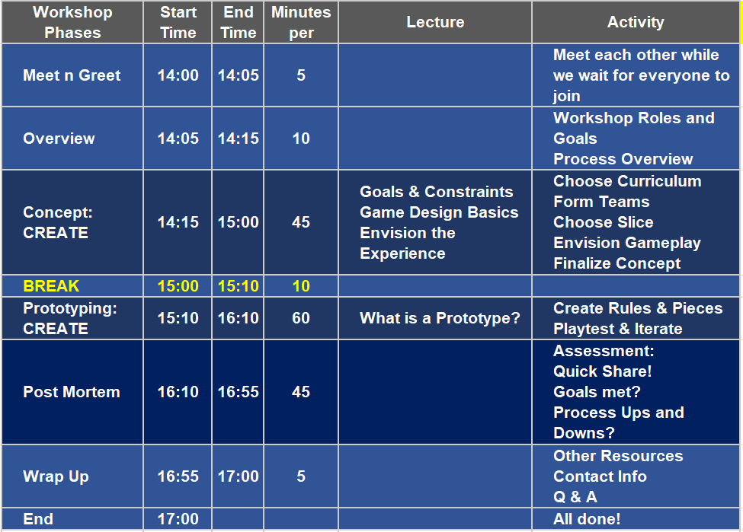
WORKSHOP SCHEDULE OVERVIEW

Slide 5
WHY USE GAMES TO TEACH?
Great way to apply and consolidate content
Requires Design Thinking (by teachers & students!)
Hits ALL the 21st Century Learning Skills
Collaboration
Critical Thinking
Creativity
Multidisciplinary
Multimodal
Makerspace
Can be used by YOU!

Slide 6
WHAT ARE WE DOING HERE?
LEARNING AND USING a proven process that has been used successfully by Chris and Adam to create effective and engaging GBL games.
This is an exercise, not an actual game dev project.

Slide 7
WORKSHOP ELEMENTS
We WON’T be doing
Using a Toolkit or specific Software
Making a polished final game
Making a Digital Game
Being bored watching me do all the fun stuff!

Slide 8
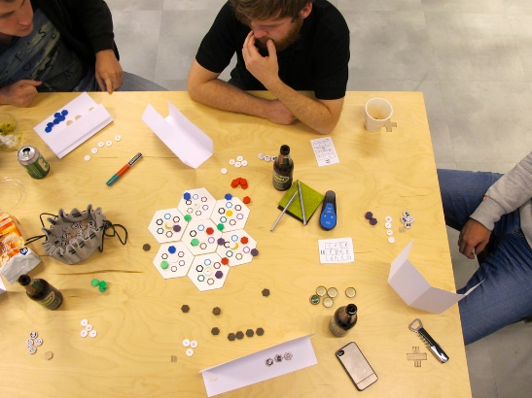
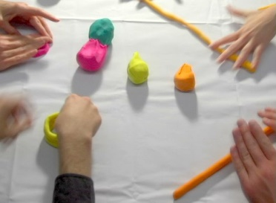
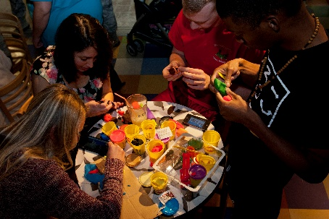
WORKSHOP ELEMENTS
Learning by Doing!
Identifying Goals and Constraints
Concepting game ideas that deliver those goals
Playtesting and making changes to get closer to the goals
Analyzing what worked and what didn’t
Making HARD decisions about what WILL and WILL NOT be in the game

Slide 9
WORKSHOP FLOW
Short Lecture
Game Shape Progresses
Group Work
Online Slide Deck

Slide 10
WORKSHOP ELEMENTS
Working as a team
Everyone contributes
Stay focused on the Goals, not your own preferences
Ensure that the game uses sound design principles and pedagogy
Delivering an ugly prototype that we are satisfied with

Slide 11
WORKSHOP OUTCOME
GAIN CONFIDENCE AND EXPERIENCE BY USING A PROCESS THAT DEVELOPS A CONCEPT INTO A PROTOTYPE.

Slide 12
MODERATOR ROLES
Producer
Guiding the Process
Pushing teams to work within the schedule
Watching the Clock (please help with this!)
Design Oversight
Droning on about Game Design Principles
Guiding to ensure all the Project Goals are considered in the Game Experience

Slide 13
YOUR ROLES
SME – Subject Matter Expert: deliver all the information about the curriculum, pedagogy, assessment, and anything else.
Designer – figure out how to make all of the above fun while ensuring the learning goals are achieved.
Artist – minimal since the game product today is an ugly prototype. So just have fun with that.
Writer – Words matter. Rules and anything else that needs writerly thinks.
Playtester – Play the game objectively and subjectively

Slide 14
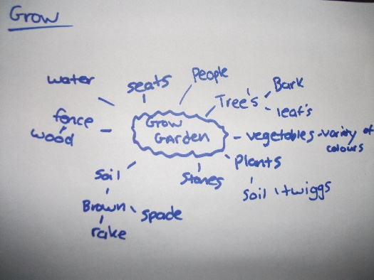
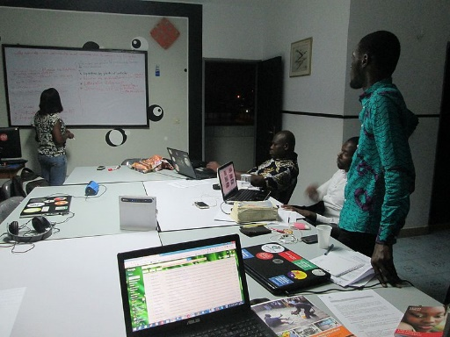
CONCEPT PHASE: LECTURE

Slide 15
CONCEPT LECTURE:
Topic: Design theory for Concept Phase
Topics:
What is a Design Concept?
Goals and Constraints
Game Design Basics
Envisioning the Experience

Slide 16
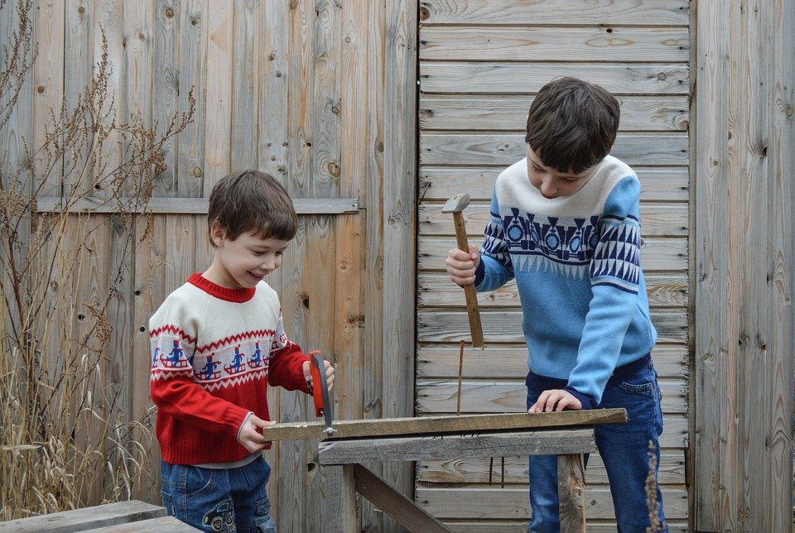
What are we making?
I have no idea!
Copyright Crowell Interactive Inc. ‹#›

Slide 17
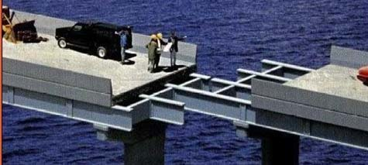
Planning is important
Copyright Crowell Interactive Inc. ‹#›

Slide 18
WHAT IS A “DESIGN CONCEPT”?
It's the initial need assessment and plan
that states why and how
you will reach your project goals,
and what the player experience will be.

Slide 19
WHAT IS A DESIGN?
A Design is a Solution
for a Need
Notes:
=============================
Image
https://www.goodfreephotos.com/vector-images/old-book-vector-clipart.png.php
https://www.publicdomainpictures.net/en/view-image.php?image=74355&picture=silhouette-women-profile
https://publicdomainvectors.org/en/free-clipart/Personal-computer-configuration-vector-clip-art/28115.html

Slide 20
CONCEPT: CREATE

Slide 21
CONCEPT DEV: OVERVIEW
Deliverable: A game concept with clear Goals and some game ideas that will achieve them.
Process:
Brainstorm fields of interest, form teams
ID Goals and Constraints
Focus on slice of Curriculum
Envision Gameplay
Document the Concept

Slide 22
CONCEPT: FORM TEAMS!
5 minutes!

Slide 23
CONCEPT DEV: FORM CURRICULUM TEAMS
5 Minutes
Deliverable: Everyone on a team that is focused on a curriculum of their choice.
Process:
All: Brainstorm fields/curriculums of interest. Some people may have a clear desire already, that's fine.
You: Choose which field you want to work on. Be flexible.
You: Sign up for the team who is working on that
You: Be ready to go to your Team table

Slide 24
CONCEPT: PROCESS NOTE
EACH TEAM WILL HAVE A PRINTED GOOGLE SLIDE DECK TO COLLABORATE ON

Slide 25
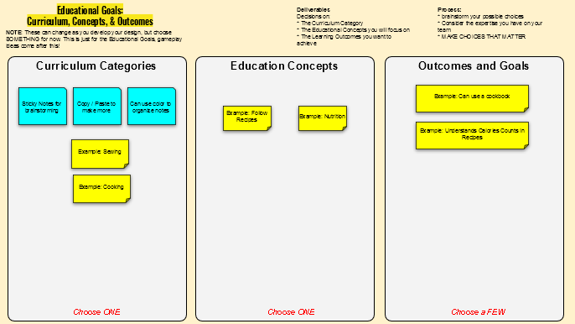
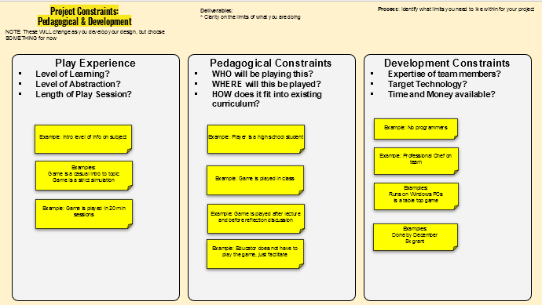
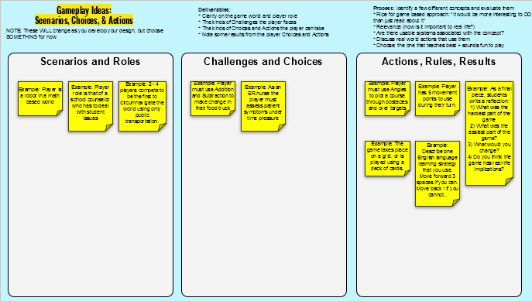
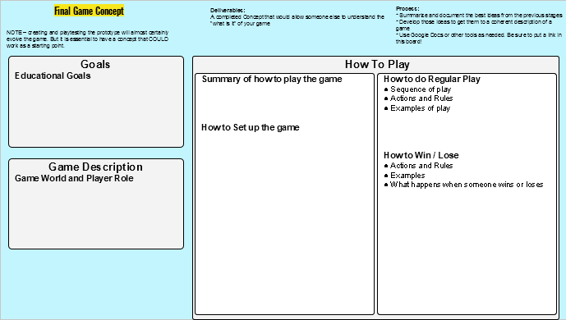
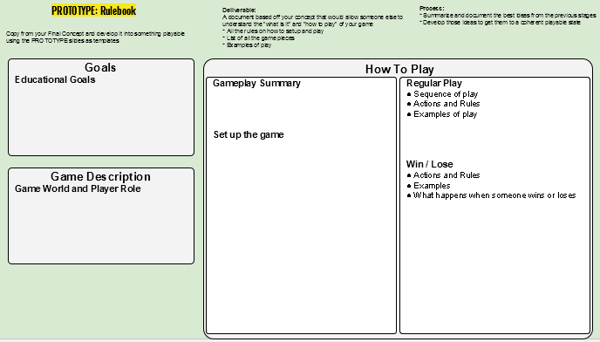
FOLLOW THE PROCESS! WORK ON EACH SLIDE PRINTOUT PAGE AS WE HIT THAT STAGE.
COMPLETE EACH STAGE WITHIN THE TIME FRAME.
YOU WILL BE ABLE TO COME BACK AND UPDATE EACH PAGE.

Slide 26
BRAINSTORM THEMES & FORM GROUPS
Lets come up with 3-4 ideas
And form groups to create games centered on them
Look in chat for the link to the Jamboard
Notes:
https://jamboard.google.com/d/15Whl7XowfLO5RjwffFWu1IjZ3dnLyqUS_liMVGylsfc/edit?usp=sharing

Slide 27
Notes:
https://jamboard.google.com/d/15Whl7XowfLO5RjwffFWu1IjZ3dnLyqUS_liMVGylsfc/edit?usp=sharing

Slide 28
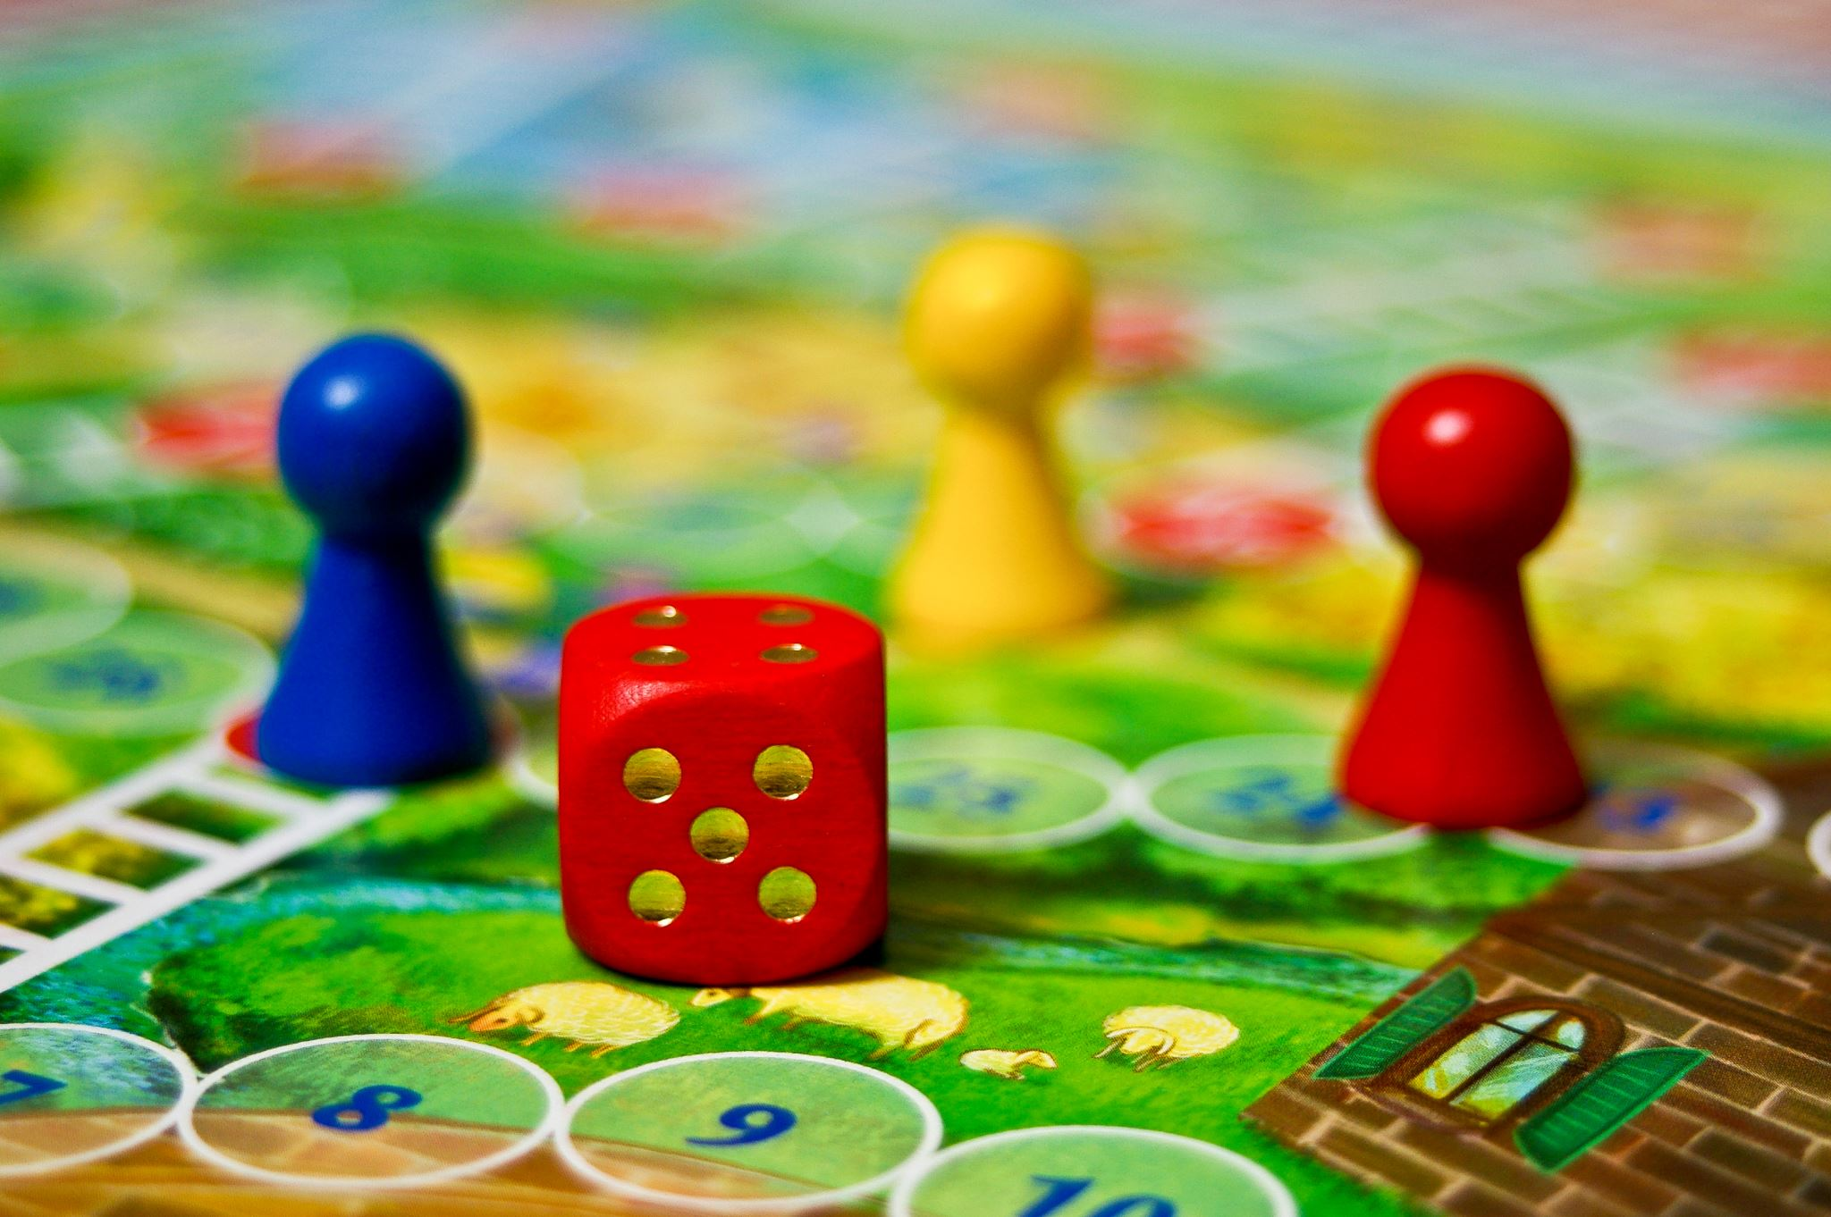
WHAT ARE THE LEARNING GOALS FOR YOUR GAME?
WHAT WILL PLAYERS LEARN FROM PLAYING YOUR GAME?
YOU CANNOT DO IT ALL.
GO FROM BIG IDEA TO SMALL NUMBER OF SPECIFICS.
Notes:
=============================
Image
https://www.goodfreephotos.com/vector-images/old-book-vector-clipart.png.php
https://www.publicdomainpictures.net/en/view-image.php?image=74355&picture=silhouette-women-profile
https://publicdomainvectors.org/en/free-clipart/Personal-computer-configuration-vector-clip-art/28115.html

Slide 29
GOAL: WHAT FIELD OF KNOWLEDGE IS BEING TAUGHT?
Curriculum Categories
Education Concepts
Sticky Notes for brainstorming
Copy / Paste to make more
Can use color to organize notes
Example: Follow Recipes
Example: Nutrition
Example: Sewing
Example: Cooking
Choose ONE
Choose ONE

Slide 30
GOAL: LEVEL OF LEARNING
Some Awareness Expert
https://starwars.fandom.com/wiki/Luke_Skywalker?file=LukeSkywalker.png
By Lucasfilm - Star Wars publicity still at https://www.lucasfilm.com/productions/episode-iv/g, Fair use, https://en.wikipedia.org/w/index.php?curid=38400241

Slide 31
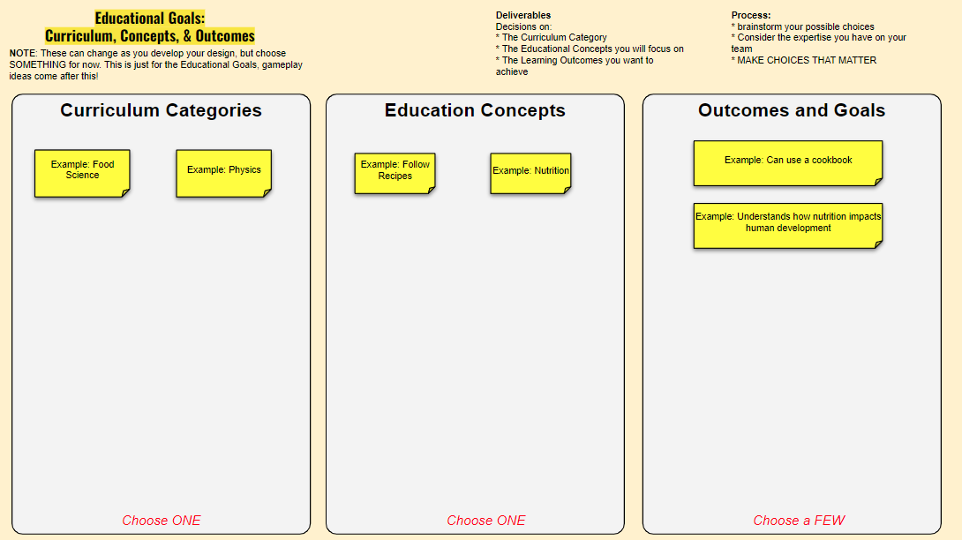
5 minutes!
REMEMBER - This is about learning the process, not creating a perfect game
Notes:
Group Time
Choose Educational Goals

Slide 32
CONCEPT DEV: CHOOSE LEARNING OUTCOME
Deliverable:
1 Section that the game will focus on
The expected Learning Outcomes from playing the game
Process: Identify a few different concepts and evaluate them
Focus from a broad curriculum to just 1 or 2 learning goals
Ripe for game-based approach: “It would be more interesting to DO than just read about it”
Relevance: How is it important to real life?
Are there usable systems associated with the concept?
Discuss real world actions that use them
Choose: the one that teaches best + sounds fun to play

Slide 33
GOAL: LEVEL OF LEARNING
Some Awareness Expert

Slide 34
PLAY EXPERIENCE AND CONSTRAINTS
WHAT KIND OF GAME EXPERIENCE DO YOU WANT FOR THE PLAYER?
WHAT CONSTRAINTS ARE THERE ON THIS PROJECT?
Notes:
=============================
Image
https://www.goodfreephotos.com/vector-images/old-book-vector-clipart.png.php
https://www.publicdomainpictures.net/en/view-image.php?image=74355&picture=silhouette-women-profile
https://publicdomainvectors.org/en/free-clipart/Personal-computer-configuration-vector-clip-art/28115.html

Slide 35
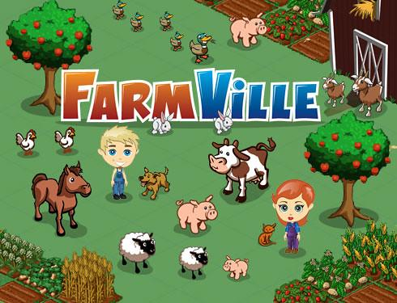
CONSTRAINT: LEVEL OF ABSTRACTION?
Casual Realistic

Slide 36
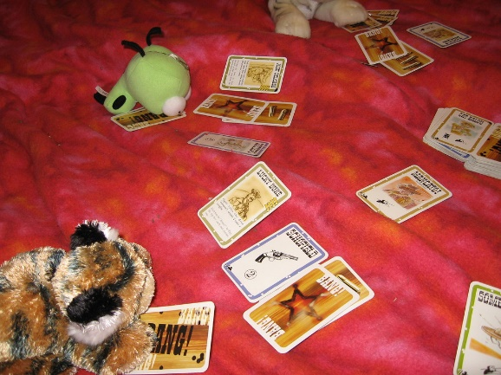
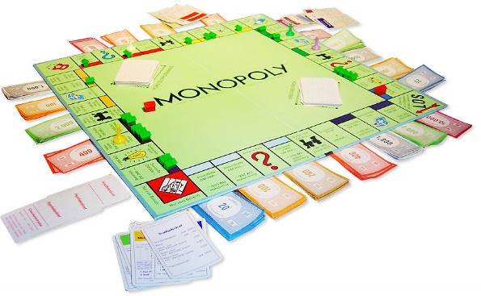
CONSTRAINT: LENGTH OF PLAY SESSION?
Quick Session Marathon

Slide 37
OTHER CONSTRAINTS:
Pedagogical Constraints
WHO will be playing this?
WHERE will this be played?
HOW does it fit into existing curriculum?

Slide 38
IMPLEMENTATION FLOW
Layout a simple plan for how you will fit the game experience into the overall pedagogical approach? Here is an example:
Pre Game Discussion
Intro concepts
Play Game
Experience use of concepts
Post Game Discussion
Consider the use and outcomes of using the concepts

Slide 39
OTHER CONSTRAINTS:
Development Constraints
Expertise of team members?
Target Technology?
Time and Money available?

Slide 40
CONCEPT DEV: GOALS AND CONSTRAINTS
Deliverable:
A statement of Goals and Constraints
Process
Discuss and fill in the Goals and Constraints sections of the Game Concept document

Slide 41
5 minutes!
Notes:
Group Time
Discuss what limits your design

Slide 42
GAMEPLAY IDEAS
PLAYFUL USE OF CONCEPTS AND SETTING
Notes:
=============================
Image
https://www.google.com/url?sa=i&url=https%3A%2F%2Fwww.jessicagavin.com%2Fhow-to-measure-ingredients%2F&psig=AOvVaw3HPSqZserz-k8rUEC_gnmZ&ust=1644785067992000&source=images&cd=vfe&ved=0CAsQjRxqFwoTCJjvvP-D-_UCFQAAAAAdAAAAABAG

Slide 43
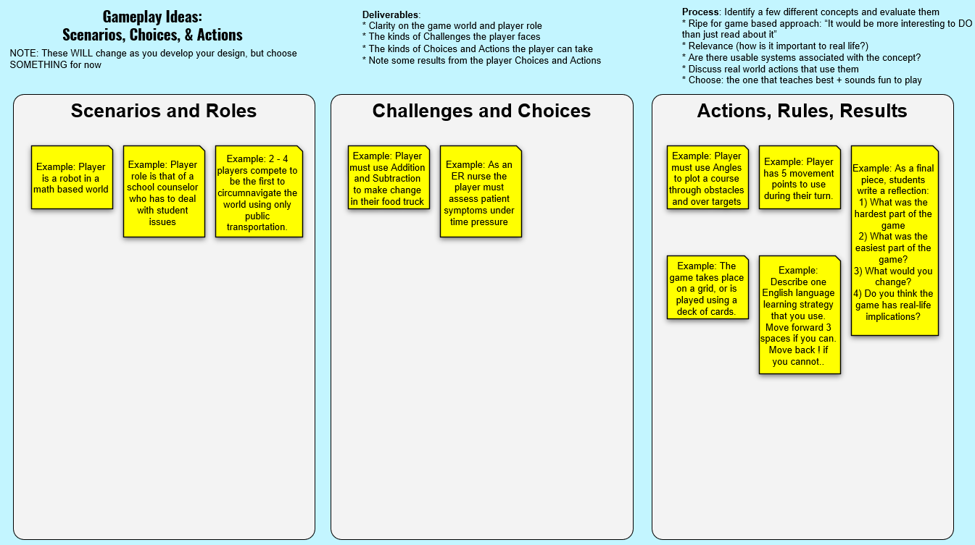
Don’t complete these sections yet, just Scenario’s and Roles.
5 minutes!

Slide 44
Challenges, Actions, Results
WHAT KIND OF CHALLENGES SHOULD THE PLAYER FACE?
WHAT ACTIONS RELATED TO THE CURRICULUM CAN THEY TAKE?
WHAT HAPPENS WHEN THEY SUCCEED OR FAIL?
Notes:
=============================
Image
https://www.goodfreephotos.com/vector-images/old-book-vector-clipart.png.php
https://www.publicdomainpictures.net/en/view-image.php?image=74355&picture=silhouette-women-profile
https://publicdomainvectors.org/en/free-clipart/Personal-computer-configuration-vector-clip-art/28115.html

Slide 45
Design Theory: The medium of Games
Other media experiences are authored by the creator, and ‘witnessed’ by the audience
Games are different in a powerful way
Game experiences are dynamically co-authored by the designer and the player
Copyright Crowell Interactive Inc. ‹#›
Notes:
=============================
Image
https://www.goodfreephotos.com/vector-images/old-book-vector-clipart.png.php
https://www.publicdomainpictures.net/en/view-image.php?image=74355&picture=silhouette-women-profile
https://publicdomainvectors.org/en/free-clipart/Personal-computer-configuration-vector-clip-art/28115.html

Slide 46
DESIGN THEORY: AGENCY
Agency is the degree to which a player
is able to cause significant change
in a game world.
Rolling a die or doing what a card tells you is NOT Agency.
Making a CHOICE is Agency. Give your players choices!

Slide 47
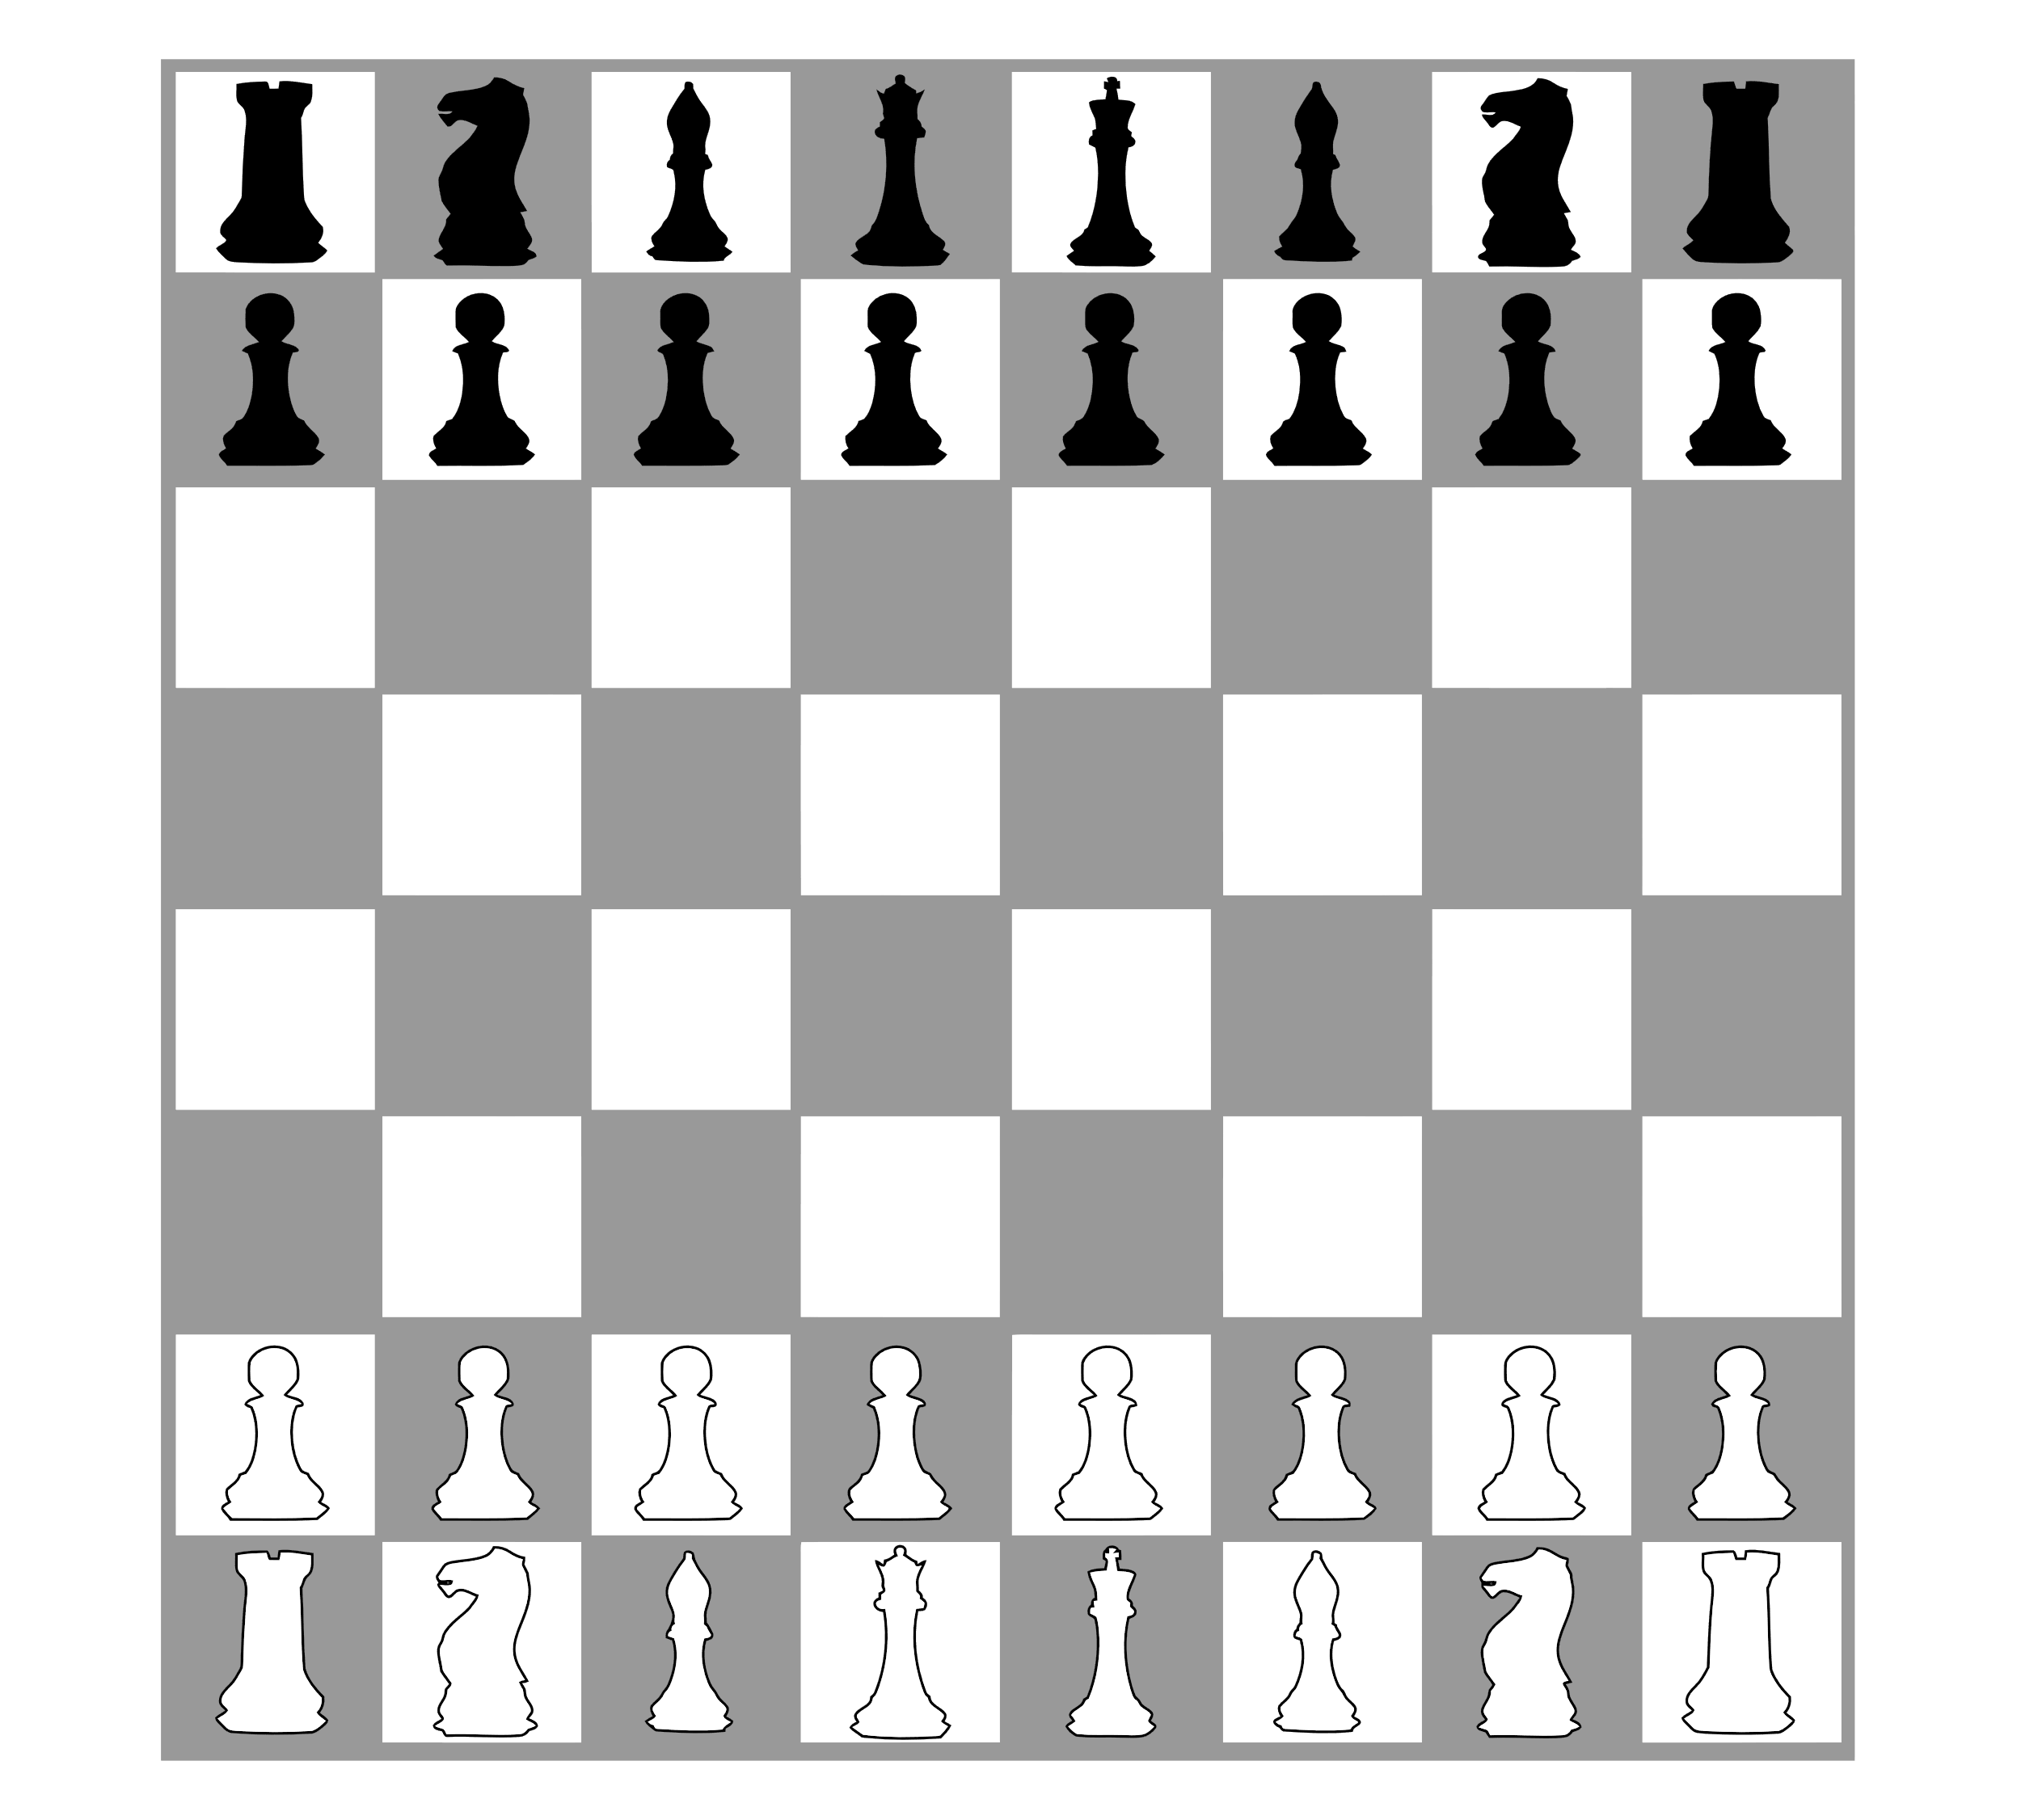
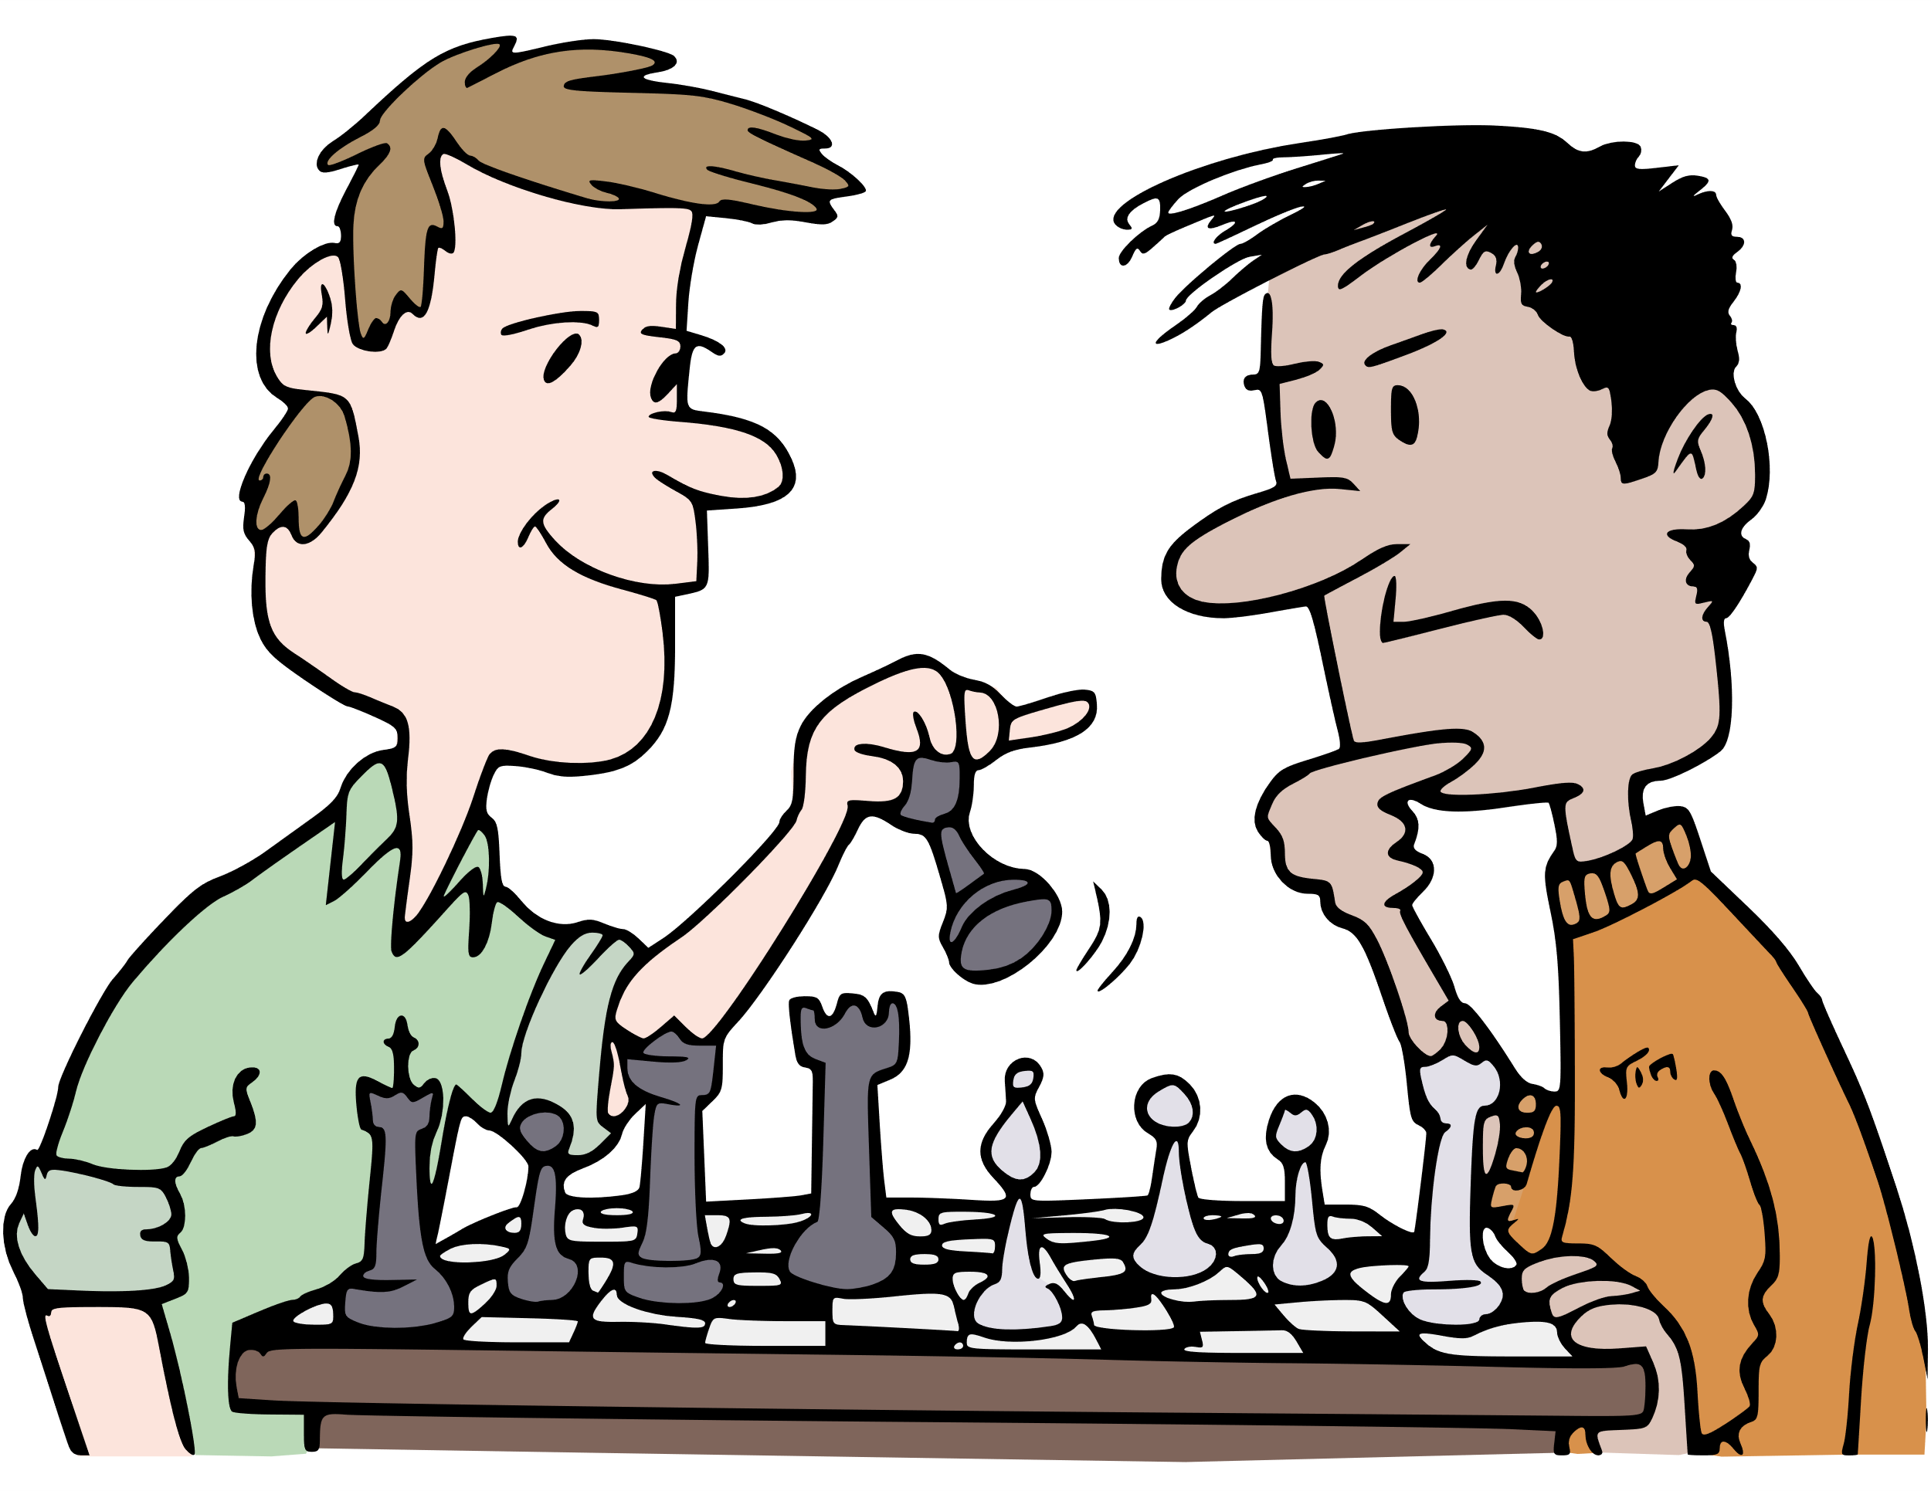
Design Theory: MDA framework
The Game Experience is created by Players interacting with Game Elements
Chess Rules
Rules
MECHANICS Game Elements
DYNAMICS Game Experience
AESTHETICS Players
Copyright Crowell Interactive Inc. ‹#›
Notes:
=============================
Image
https://www.goodfreephotos.com/vector-images/old-book-vector-clipart.png.php
https://www.publicdomainpictures.net/en/view-image.php?image=74355&picture=silhouette-women-profile
https://publicdomainvectors.org/en/free-clipart/Personal-computer-configuration-vector-clip-art/28115.html

Slide 48
Game Activity in a nutshell
Games have Rules that define all the concepts below
Players are given one or more Goals
Challenges prevent them from instantly achieving the goals
Players Plan, Choose, and Execute actions to overcome the challenges
Players learn from the success or failure of their gameplay
They do this repeatedly until they reach their goals or fail the game

Slide 49
DESIGN THEORY: COGNITIVE LOOP OF PLAY
Player must be able to make sense of the game
Player must be able to see how the action changed the game state
Observe
Game State
Results Evaluate what happened
Plan
Choices!
Do
Execute the plan
Player must be able to predict and make choices
Player must be able to enact their Plan

Slide 50
Make fast decisions.
Consider on real life use of this info.
You will be able to revise later as needed
5 minutes!

Slide 51
Choose and evolve your game concept
Begin to see how your concept elements are beginning to take shape
Plan a coherent game experience from start to finish
Think deeper about all aspects
Define how the game is completed or exited
Notes:
=============================
Image
https://www.goodfreephotos.com/vector-images/old-book-vector-clipart.png.php
https://www.publicdomainpictures.net/en/view-image.php?image=74355&picture=silhouette-women-profile
https://publicdomainvectors.org/en/free-clipart/Personal-computer-configuration-vector-clip-art/28115.html

Slide 52
DESIGN THEORY: CORE GAMEPLAY LOOP
What does the player do to Win?
How can they lose?
Observe
Understand
Progress
Win
Player
Plan
Choices!
Results Evaluate what happened
Failure
Lose
Do
Execute the plan
Player overcomes Challenges by doing X until they achieve Y, which is the Victory Condition

Slide 53
DESIGN THEORY: THE GOLDEN PATH
How does the player go from start to finish via gameplay?
What challenges & choices will they face, and where do those choices lead them?
Win
Start
Lose
Player makes choices that lead to different challenges until they finish the game

Slide 54
DESIGN THEORY: DOMINANT STRATEGY
Definition: One way is much better than all the others
Win
Start
Lose
Using the Curriculum is the way to win
The Process could be the Curriculum

Slide 55
DESIGN THEORY: GAMEPLAY & CURRICULUM
Have the gameplay make the player USE the curriculum concepts
Do not win or lose by luck!
Win by knowing or using the curriculum concepts

Slide 56
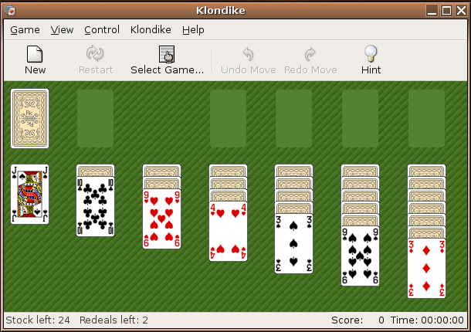
DESIGN THEORY: RANDOMNESS
Unique challenges in every play session

Slide 57
Design Theory: Randomness in Outcome
Does not use concepts, so does not progress toward learning outcomes
Can lead to misunderstanding of concepts
Copyright Crowell Interactive Inc. ‹#›

Slide 58
Design Theory: Randomness
Dice operate on “INDEPENDENT probability” – they have no memory of the last roll, so the probability of getting a particular outcome on your next try is always the same.
Decks operate on “DEPENDENT probability” – once you’ve dealt a card, it’s not in the deck anymore, so the range of possible outcomes from the next deal is smaller.
Copyright Crowell Interactive Inc. ‹#›

Slide 59
DESIGN THEORY: COGNITIVE LOOP OF PLAY
Randomness is good ONLY HERE
Observe
Game State
Evaluate Did it work?
Plan
Choices!
Do
Execute the plan

Slide 60
Design Theory: Uncertainty & Risk
To engage players, a game needs to be uncertain.
No Risk
Comfortable Risk
Too Much Risk
No risk robs the choices of meaning.
Boring!
A good game allows a player to explore the choices, and find one that feels possible if they play well.
Satisfying!
If the player could lose too much, then the choice feels punitive and unfair.
Frustrating!
Copyright Crowell Interactive Inc. ‹#›

Slide 61
EMERGENT DESIGN: 1 + 1 = 3
Design rules & mechanics that interact with each other.

Slide 62
EMERGENT DESIGN: 1 + 1 = 3
Design rules & mechanics that interact with each other.
Doctor
Triage
Cadet Nurse
Can see 2 patients per turn
+2 patients seen per turn
See 1 Patient per Turn OR Can do Triage

Slide 63
CONCEPT DEV: ENVISION GAMEPLAY
Deliverable:
1 – 2 Actions that players will perform as the key gameplay
The Gameplay Flow (do this first, then this, then this)
Success and Fail conditions (1st Pass)
Process:
Discuss Challenges that require the player to make choices based on their understanding the concepts
Reference real life use of the curriculum concepts or skills
Define the actions the player would do that use the concepts
Describe how player choices and actions can lead to winning or losing
Write the rules for performing, succeeding, and failing the actions.

Slide 64
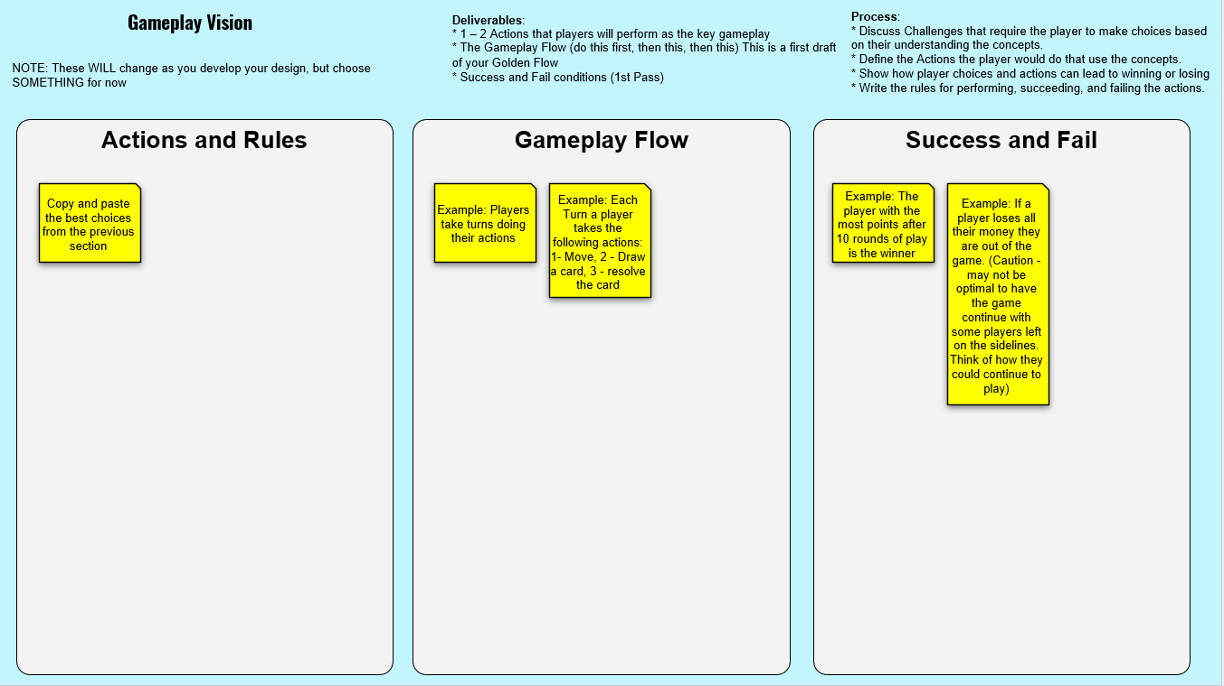
5 minutes!

Slide 65
CONCEPT DEV: FINAL CONCEPT
NOTE – creating and playtesting the prototype will almost certainly evolve the game. But it is essential to have a concept that COULD work as a starting point.
Deliverable:
Completed Concept
Process:
Clarify and write up the final Concept
This will be your guide for creating the playable prototype

Slide 66
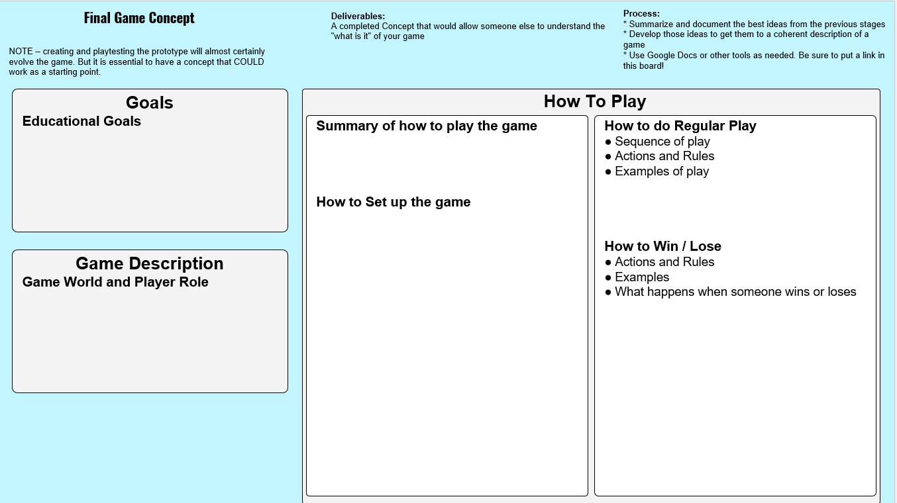
5 minutes!

Slide 67
BREAK!

Slide 68
WORKSHOP SCHEDULE OVERVIEW

Slide 69
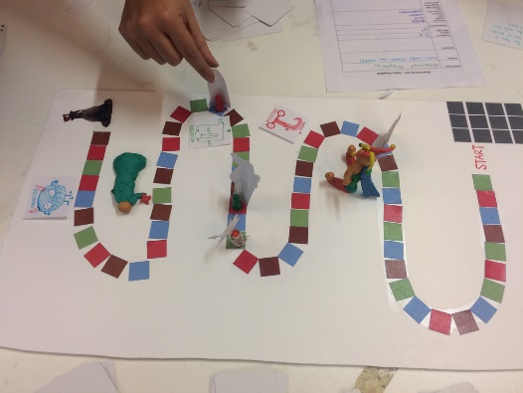
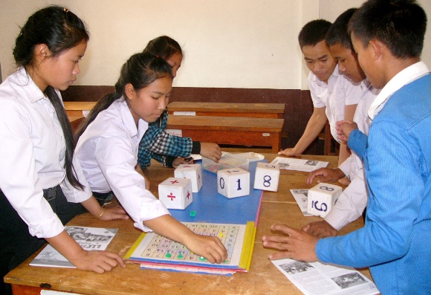
PROTOTYPE: VERY SHORT LECTURE

Slide 70
WHAT IS A PROTOTYPE?
A prototype is a draft version of a product that allows you to explore your ideas and show the intention behind a feature or the overall design concept to users before investing time and money into development.
- https://www.usability.gov/how-to-and-tools/methods/prototyping.html

Slide 71
CONSIDERATIONS FOR THE DEVELOPMENT PHASE
Use the Concept as a guide
Gameplay should REQUIRE using the curriculum
Craft it, Play it, Review, and Evolve it

Slide 72
PROTOTYPE: CREATE, PLAY, REVIEW, EVOLVE
Deliverable: Ugly Prototype that achieves the Goals.
Process: See chart 🡺
1: Create/Update
Create and Update the game pieces and rules
3: Review
Are Concepts being used as gameplay?
Pedagogy solid?
Meaningful choices?
Balance: Easy/Hard
What should be changed?
2: Playtest
Watch for Blockages
Increasingly depend on Rules exactly as written.
Update changes as needed.

Slide 73
WORKSHOP SCHEDULE CREATE PROTOTYPE
Workshop Phases | Start Time | End Time | Minutes per | Activity
Meet n Greet | 10:00 | 10:10 | 10 | Meet each other while we wait for everyone to join
Overview | 10:10 | 10:20 | 10 | Workshop Roles and Goals Process Overview
Concept Lecture | 10:20 | 10:45 | 25 | Goals & Constraints Game Design Basics Envision the Experience
Concept: Create | 10:45 | 11:45 | 60 | Choose Curriculum Form Teams Choose Slice Envision Gameplay Finalize Concept
LUNCH | 11:45 | 12:45 | 60
Prototyping Lecture | 12:45 | 13:00 | 15
Prototyping: Create | 13:00 | 14:10 | 70 | Create Rules & Pieces Playtest & Iterate
Post Mortem | 14:10 | 14:40 | 30 | Assessment: Quick Share! Goals met? Process Ups and Downs?
Wrap Up | 14:40 | 14:50 | 10 | Other Resources Contact Info Q & A
End | 14:50 |  |  | All done!
Copyright Crowell Interactive Inc.

Slide 74
PROTOTYPE DEV

Slide 75
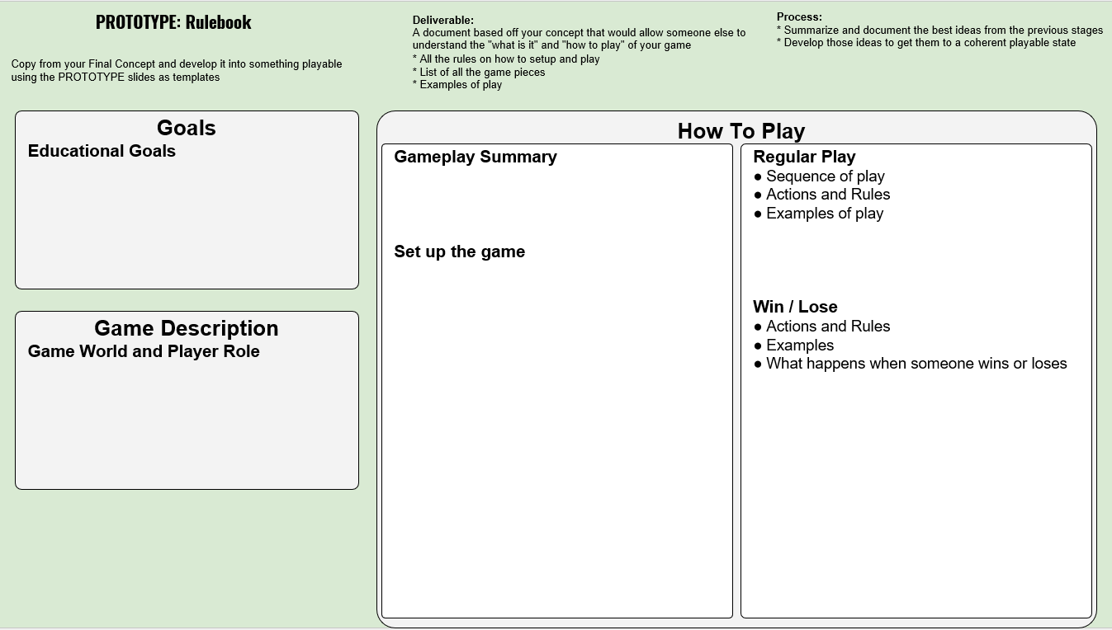

Slide 76
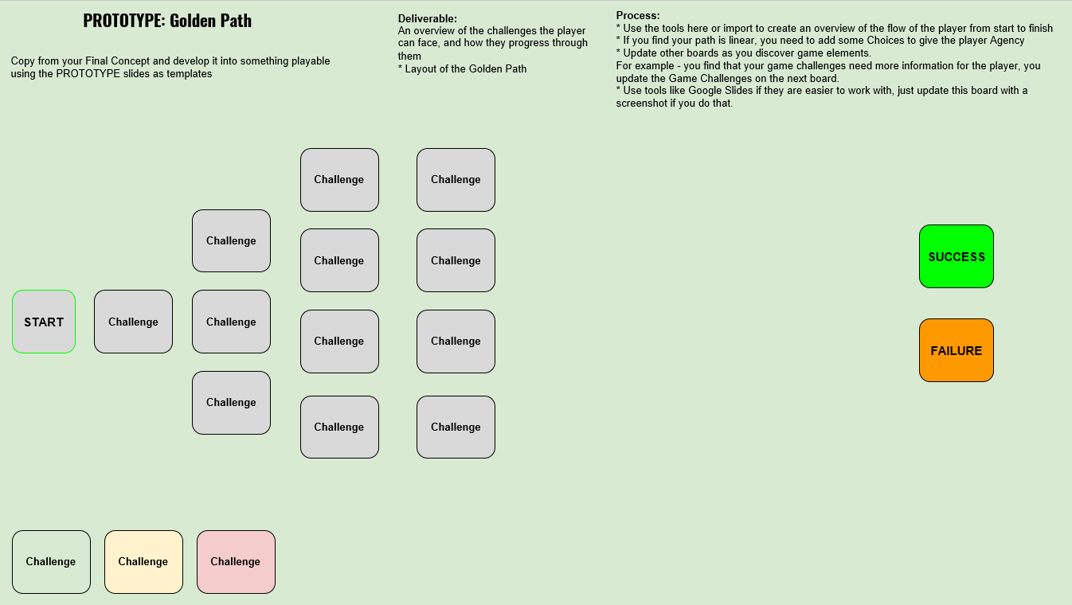

Slide 77
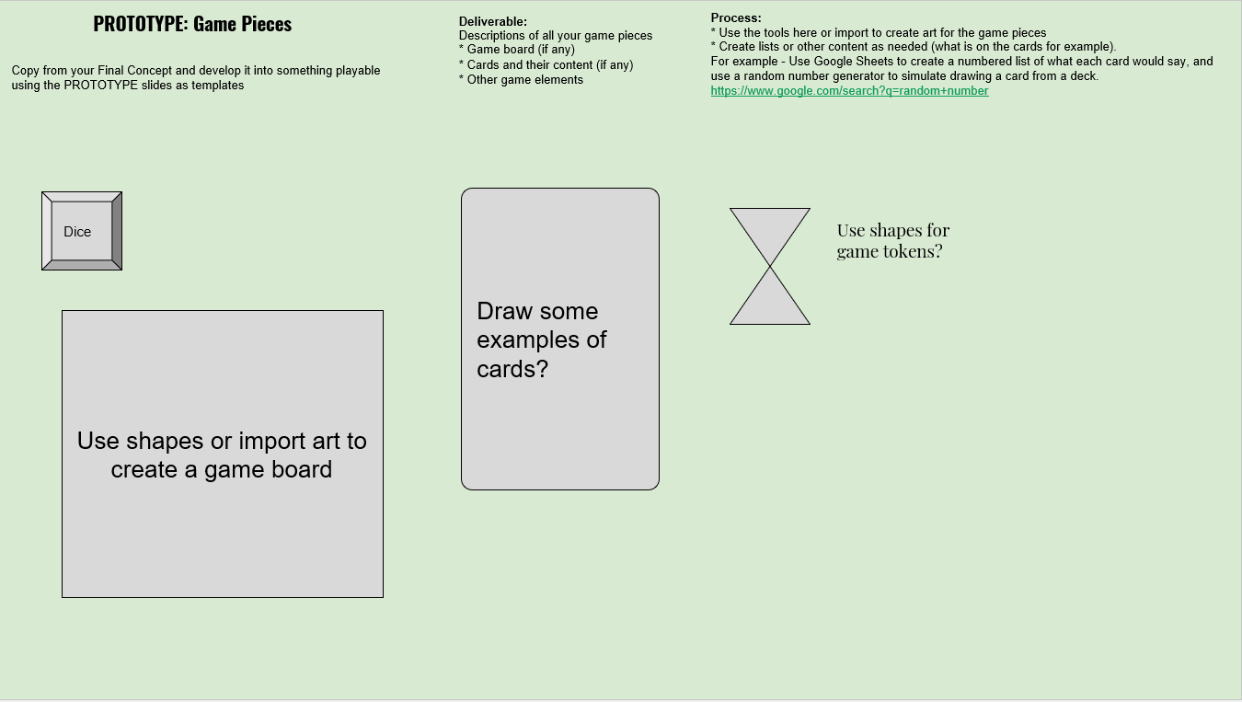

Slide 79
GO TO BREAKOUT ROOMS

Slide 80
WORKSHOP SCHEDULE PROJECT POSTMORTEMS
Workshop Phases | Start Time | End Time | Minutes per | Activity
Meet n Greet | 10:00 | 10:10 | 10 | Meet each other while we wait for everyone to join
Overview | 10:10 | 10:20 | 10 | Workshop Roles and Goals Process Overview
Concept Lecture | 10:20 | 10:45 | 25 | Goals & Constraints Game Design Basics Envision the Experience
Concept: Create | 10:45 | 11:45 | 60 | Choose Curriculum Form Teams Choose Slice Envision Gameplay Finalize Concept
LUNCH | 11:45 | 12:45 | 60
Prototyping Lecture | 12:45 | 13:00 | 15
Prototyping: Create | 13:00 | 14:10 | 70 | Create Rules & Pieces Playtest & Iterate
Postmortems | 14:10 | 14:40 | 30 | Assessment: Quick Share! Goals met? Process Ups and Downs?
Wrap Up | 14:40 | 14:50 | 10 | Other Resources Contact Info Q & A
End | 14:50 |  |  | All done!

Slide 81
POST MORTEM: REVIEW THE PROCESS
Deliverable:
Points to cover:
Each team gives a SHORT (~ 5 min) presentation about their game :
Your Goals
Education?
Pedagogy?
Engagement?
What Went Right?
Next Time We would…?

Slide 82
WORKSHOP SCHEDULE WORKSHOP SUMMARY
Workshop Phases | Start Time | End Time | Minutes per | Activity
Meet n Greet | 10:00 | 10:10 | 10 | Meet each other while we wait for everyone to join
Overview | 10:10 | 10:20 | 10 | Workshop Roles and Goals Process Overview
Concept Lecture | 10:20 | 10:45 | 25 | Goals & Constraints Game Design Basics Envision the Experience
Concept: Create | 10:45 | 11:45 | 60 | Choose Curriculum Form Teams Choose Slice Envision Gameplay Finalize Concept
LUNCH | 11:45 | 12:45 | 60
Prototyping Lecture | 12:45 | 13:00 | 15
Prototyping: Create | 13:00 | 14:10 | 70 | Create Rules & Pieces Playtest & Iterate
Post Mortem | 14:10 | 14:40 | 30 | Assessment: Quick Share! Goals met? Process Ups and Downs?
Wrap Up | 14:40 | 14:50 | 10 | Other Resources Contact Info Q & A
End | 14:50 |  |  | All done!

Slide 83
WORKSHOP POSTMORTEM: REGARDING THE PROCESS
The workshop was focused on a specific flavor of Game Based Learning game
But with tweaking, the process works for any game development project you want to conceptualize.

Slide 84
Q & A + RESOURCES
Time to ask final questions
Process: Ask Questions!
Download the slides.
Chris Info
crowellinteractive@gmail.com
www.crowellinteractive.ca
www.linkedin.com/in/chriswombatcrowell
Some Other Resources:
Gamasutra Game Design
https://gamasutra.com/category/design/
Learning Games Network
learninggamesnetwork.org/
Game Jam Guide pdf
bit.ly/GJGuide
Teacher Pioneers pdf
press.etc.cmu.edu/index.php/product/teacher-pioneers/
Adam Info
adam@werocreative.com
http://werocreative.com/
https://www.linkedin.com/in/adam-clare-7a41142/

Slide 85
WORKSHOP SCHEDULE
Workshop Phases | Start Time | End Time | Minutes per | Activity
Meet n Greet | 10:00 | 10:10 | 10 | Meet each other while we wait for everyone to join
Overview | 10:10 | 10:20 | 10 | Workshop Roles and Goals Process Overview
Concept Lecture | 10:20 | 10:45 | 25 | Goals & Constraints Game Design Basics Envision the Experience
Concept: Create | 10:45 | 11:45 | 60 | Choose Curriculum Form Teams Choose Slice Envision Gameplay Finalize Concept
LUNCH | 11:45 | 12:45 | 60
Prototyping Lecture | 12:45 | 13:00 | 15
Prototyping: Create | 13:00 | 14:10 | 70 | Create Rules & Pieces Playtest & Iterate
Post Mortem | 14:10 | 14:40 | 30 | Assessment: Quick Share! Goals met? Process Ups and Downs?
Wrap Up | 14:40 | 14:50 | 10 | Other Resources Contact Info Q & A
End | 14:50 |  |  | All done!

