Slide 1
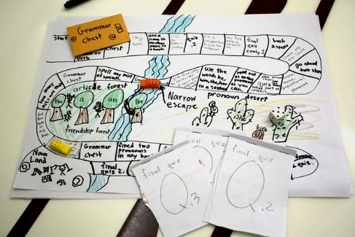
WELCOME TO THE “LET’S MAKE A GAME” WORKSHOP
Download the slides.
3 HR. VERSION
FACILITATED BY CHRIS ‘WOMBAT’ CROWELL
PERFORMED BY ‘YOU’

Slide 2
WHO IS THIS GUY?
Chris Wombat Crowell
Game Design and Creative Direction since 1994
Worked At Electronic Arts, Maxis, Ubisoft, others
Now teaching Game Design at Sheridan College
And working as Crowell Interactive to assist educators like you to create awesome Game Based Learning and Educational Gamification

Slide 3
WHO IS THIS OTHER GUY?
Adam Clare
Game Design and Creative Direction since 1994
Worked At Electronic Arts, Maxis, Ubisoft, others
Now teaching Game Design at Sheridan College
And working as Crowell Interactive to assist educators like you to create awesome Game Based Learning and Educational Gamification

Slide 4
WORKSHOP SCHEDULE OVERVIEW
Workshop Phases | Start Time | End Time | Minutes per | Activity
Meet n Greet | 17:00 | 17:05 | 5 | Meet each other while we wait for everyone to join
Overview | 17:05 | 17:15 | 10 | Workshop Roles and Goals Process Overview
Concept Lecture | 17:15 | 17:45 | 30 | Goals & Constraints Game Design Basics Envision the Experience
Concept: CREATE | 17:45 | 18:15 | 30 | Choose Curriculum Form Teams Choose Slice Envision Gameplay Finalize Concept
BREAK | 18:15 | 18:25 | 10
Prototyping Lecture | 18:25 | 18:35 | 10 | What is a Prototype?
Prototyping: CREATE | 18:35 | 19:35 | 60 | Create Rules & Pieces Playtest & Iterate
Post Mortem | 19:35 | 19:55 | 20 | Assessment: Quick Share! Goals met? Process Ups and Downs?
Wrap Up | 19:55 | 20:00 | 5 | Other Resources Contact Info Q & A
End | 20:00 |  |  | All done!

Slide 5
WHY USE GAMES TO TEACH?
Great way to apply and consolidate content
Requires Design Thinking (by teachers & students!)
Hits ALL the 21st Century Learning Skills
Collaboration
Critical Thinking
Creativity
Multidisciplinary
Multimodal
Maker Space
Can be used by YOU!

Slide 6
WHAT ARE WE DOING HERE?
Learning a proven process that has been used by Chris and Adam to successfully create effective and engaging GBL games.

Slide 7
WORKSHOP ELEMENTS
We WON’T be doing
Using a Toolkit or specific Software
Making a polished final game
Making a Digital Game
Being bored watching us do all the fun stuff!

Slide 8
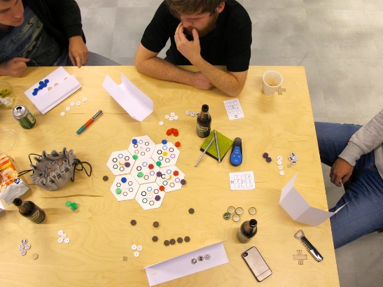
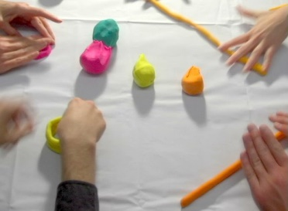
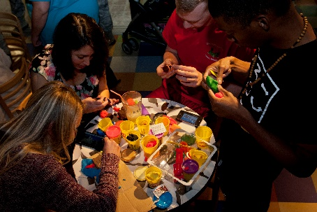
WORKSHOP ELEMENTS
Learning by Doing!
Identifying Goals and Constraints
Concepting game ideas that deliver those goals
Playtesting and making changes to get closer to the goals
Making HARD decisions about what WILL and WILL NOT be in the game
Analyzing what worked and what didn’t
Working as a team
Everyone contributes
Stay focused on the Project Goals, not your own preferences
Ensure that the game uses sound design principles and pedagogy
Delivering an ugly prototype that we are satisfied with

Slide 9
WORKSHOP OUTCOME
GAIN CONFIDENCE AND EXPERIENCE BY USING A PROCESS THAT DEVELOPS A CONCEPT INTO A PROTOTYPE.

Slide 10
MODERATOR ROLES
Producer
Guiding the Process
Making Final Decisions
Watching the Clock (please help with this!)
Design Oversight
Ensuring all the Project Goals are included in the Game Experience
Droning on about Game Design Principles

Slide 11
YOUR ROLES
SME – Subject Matter Expert: deliver all the information about the curriculum, pedagogy, assessment, and anything else.
Designer – figure out how to make all of the above fun while ensuring the learning goals are achieved.
Artist – minimal since the game product today is an ugly prototype. So just have fun with that.
Writer – Words matter. Rules and anything else that needs writerly thinks.
Playtester – Play the game objectively and subjectively

Slide 12
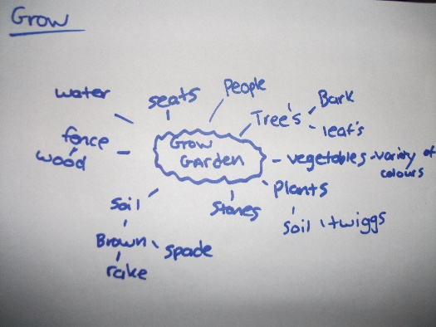
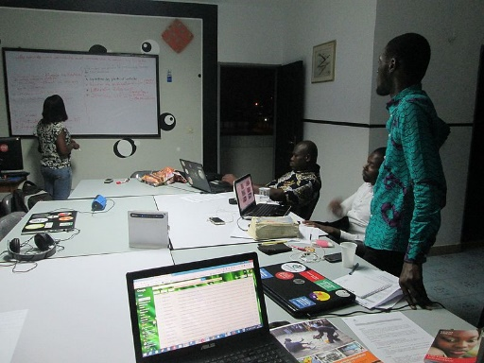
CONCEPT PHASE: LECTURE

Slide 13
CONCEPT LECTURE:
Deliverable: Design theory for Concept Phase
Topics:
What is a Design Concept?
Goals and Constraints
Game Design Basics
Envisioning the Experience

Slide 14
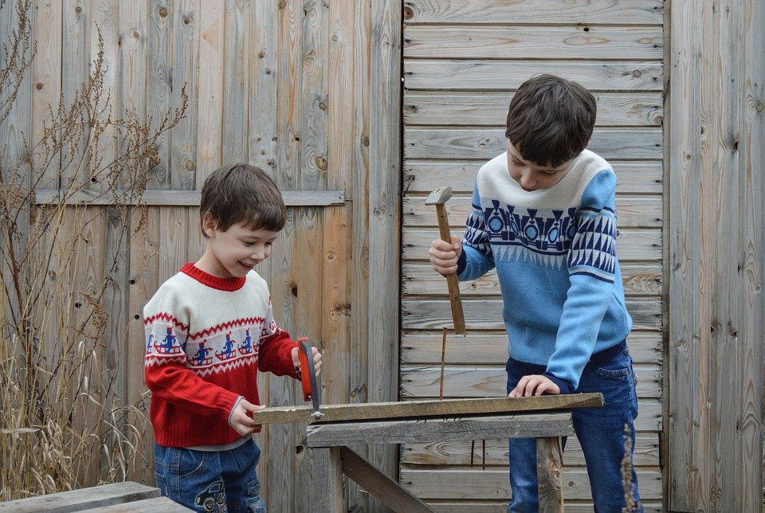
What are we making?
I have no idea!
Copyright Crowell Interactive Inc. ‹#›

Slide 15
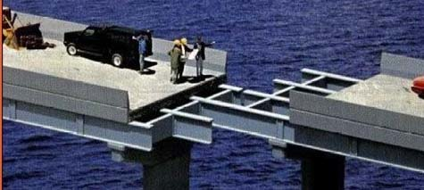
Planning is important
Copyright Crowell Interactive Inc. ‹#›

Slide 16
WHAT IS INTENTIONAL DESIGN?
It's the underlying logic, thinking, and reasoning for why and how you'll design the game, and what the player experience will be.

Slide 17
WHAT IS A DESIGN?
A Design is a Solution
for reaching a Goal
Notes:
=============================
Image
https://www.goodfreephotos.com/vector-images/old-book-vector-clipart.png.php
https://www.publicdomainpictures.net/en/view-image.php?image=74355&picture=silhouette-women-profile
https://publicdomainvectors.org/en/free-clipart/Personal-computer-configuration-vector-clip-art/28115.html

Slide 18
WHAT IS THE GOAL OF YOUR GAME?
What Learning Outcomes
are intended?
Notes:
=============================
Image
https://www.goodfreephotos.com/vector-images/old-book-vector-clipart.png.php
https://www.publicdomainpictures.net/en/view-image.php?image=74355&picture=silhouette-women-profile
https://publicdomainvectors.org/en/free-clipart/Personal-computer-configuration-vector-clip-art/28115.html

Slide 19
WHAT THE EXPERIENCE GOALS FOR YOUR GAME?
What kind of Game Experience do you want for the player?
Notes:
=============================
Image
https://www.goodfreephotos.com/vector-images/old-book-vector-clipart.png.php
https://www.publicdomainpictures.net/en/view-image.php?image=74355&picture=silhouette-women-profile
https://publicdomainvectors.org/en/free-clipart/Personal-computer-configuration-vector-clip-art/28115.html

Slide 20
GOAL: LEVEL OF LEARNING
Some Awareness Expert

Slide 21
GOAL: LEVEL OF LEARNING
Some Awareness Expert
https://starwars.fandom.com/wiki/Luke_Skywalker?file=LukeSkywalker.png
By Lucasfilm - Star Wars publicity still at https://www.lucasfilm.com/productions/episode-iv/g, Fair use, https://en.wikipedia.org/w/index.php?curid=38400241

Slide 22
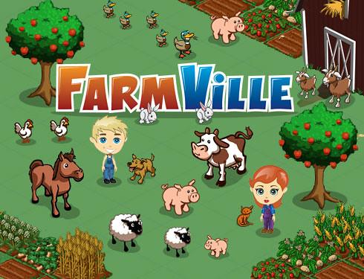
CONSTRAINT: LEVEL OF ABSTRACTION?
Casual Realistic

Slide 23
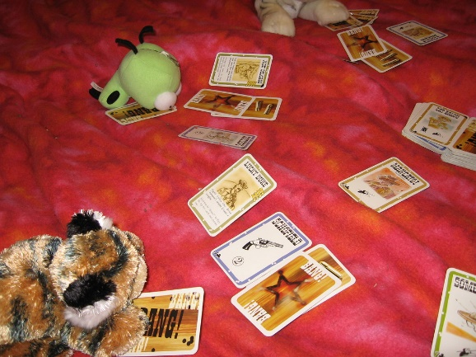
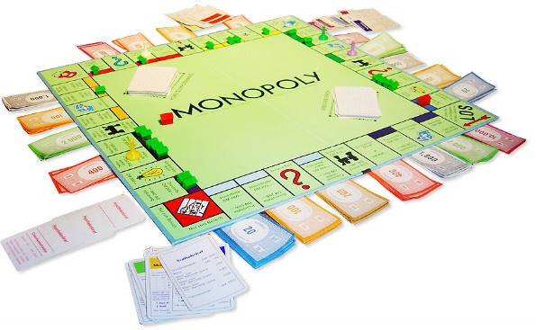
CONSTRAINT: LENGTH OF PLAY SESSION?
Quick Session Marathon

Slide 24
OTHER CONSTRAINTS:
Pedagogical Constraints
WHO will be playing this?
WHERE will this be played?
HOW does it fit into existing curriculum?
Development Constraints
Expertise of team members?
Target Technology?
Time and Money available?

Slide 25
GAME DESIGN THEORY
Game Design Theory Section
Notes:
=============================
Image
https://www.goodfreephotos.com/vector-images/old-book-vector-clipart.png.php
https://www.publicdomainpictures.net/en/view-image.php?image=74355&picture=silhouette-women-profile
https://publicdomainvectors.org/en/free-clipart/Personal-computer-configuration-vector-clip-art/28115.html

Slide 26
Design Theory: The medium of Games
Other media experiences are authored by the creator, and ‘witnessed’ by the audience
Games are different in a powerful way
Game experiences are dynamically co-authored by the designer and the player
Copyright Crowell Interactive Inc. ‹#›
Notes:
=============================
Image
https://www.goodfreephotos.com/vector-images/old-book-vector-clipart.png.php
https://www.publicdomainpictures.net/en/view-image.php?image=74355&picture=silhouette-women-profile
https://publicdomainvectors.org/en/free-clipart/Personal-computer-configuration-vector-clip-art/28115.html

Slide 27
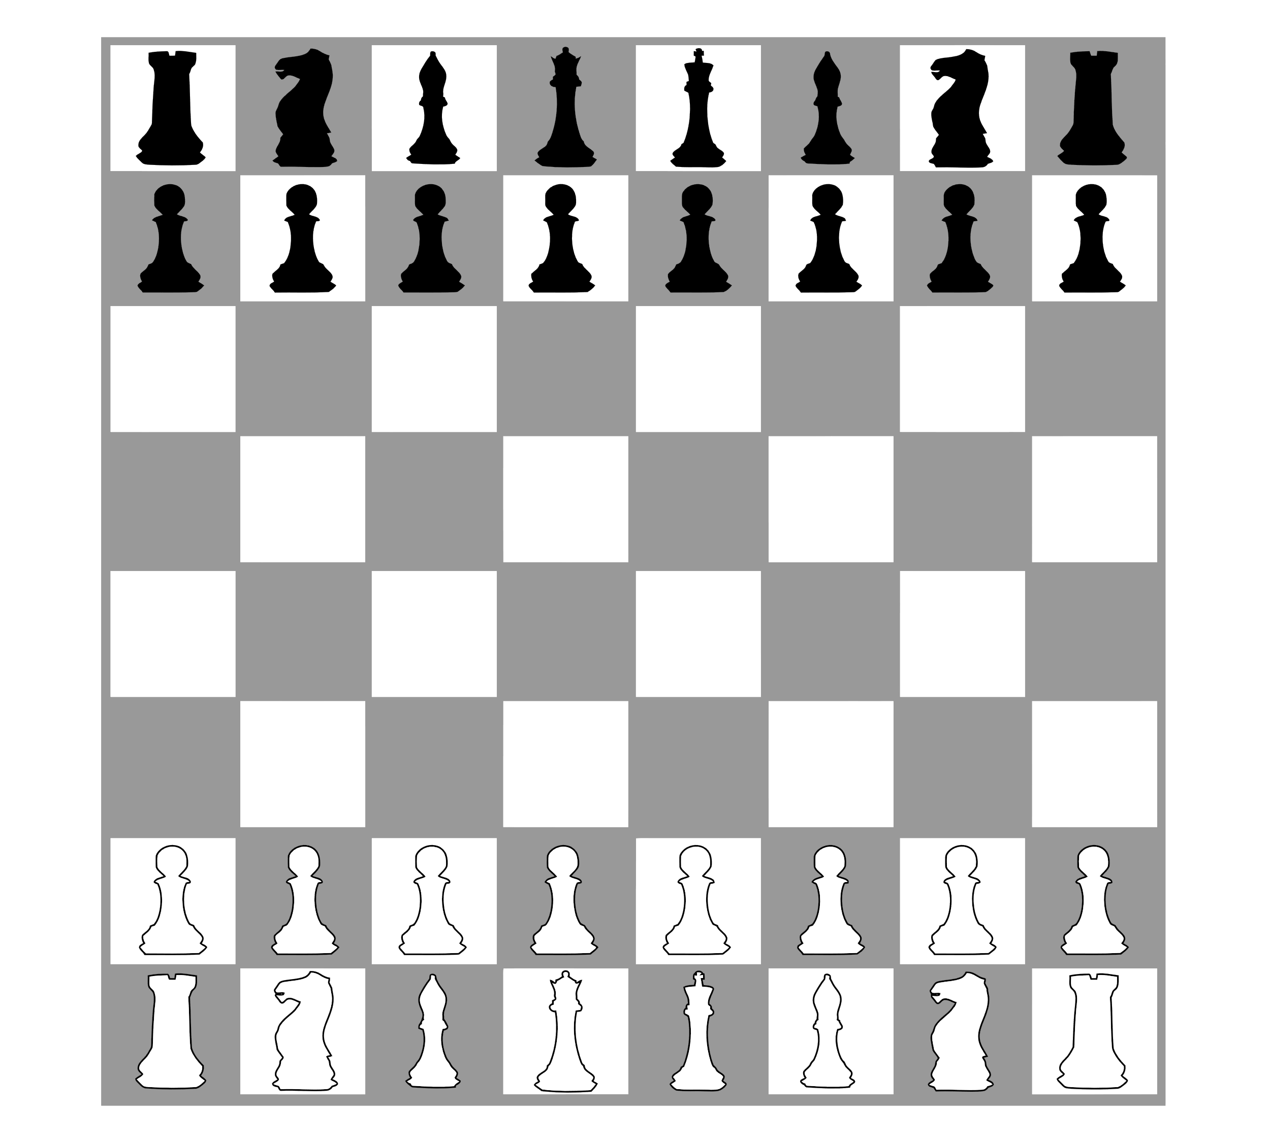
Design Theory: Game Experience
Created by Players interacting with Game Elements
Rules
Rules
Game Elements
Game Experience
Players
Copyright Crowell Interactive Inc. ‹#›
Notes:
=============================
Image
https://www.goodfreephotos.com/vector-images/old-book-vector-clipart.png.php
https://www.publicdomainpictures.net/en/view-image.php?image=74355&picture=silhouette-women-profile
https://publicdomainvectors.org/en/free-clipart/Personal-computer-configuration-vector-clip-art/28115.html

Slide 28
DESIGN THEORY: AGENCY
Agency is the degree to which a player
is able to cause significant change
in a game world.
Rolling a die or doing what a card tells you is NOT Agency.
Making a choice IS Agency. Give your players choices!

Slide 29
DESIGN THEORY: COGNITIVE LOOP OF PLAY
Observe
Game State
Evaluate Did it work?
Plan
Choices!
Do
Execute the plan

Slide 30
DESIGN THEORY: EACH CHALLENGE
What does the player do to Win?
How can they lose?
Observe
Understand
Progress
Win
Player
Evaluate Did it work?
Plan
Choices!
Failure
Lose
Do
Execute the plan
Player overcomes Challenges by doing X until they achieve Y, which is the Victory Condition

Slide 31
DESIGN THEORY: THE GOLDEN PATH
How does the player go from start to finish via gameplay?
What choices can they make, and where do those choices lead them?
Win
Start
Lose
Player makes choices that lead to different challenges until they finish the game

Slide 32
DESIGN THEORY: DOMINANT STRATEGY
Definition: One way is much better than all the others
Win
Start
Lose
Using the Curriculum is the way to win
The Process could be the Curriculum

Slide 33
DESIGN THEORY: GAMEPLAY & CURRICULUM
Have the gameplay make the player USE the curriculum concepts
Win by knowing or using the curriculum concepts
Do not win by luck!

Slide 34
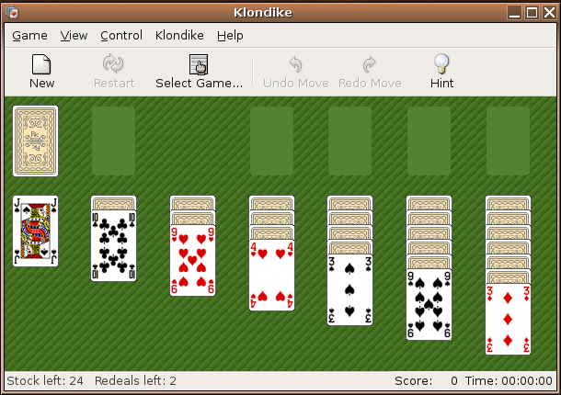
DESIGN THEORY: RANDOMNESS
Unique challenges in every play session

Slide 35
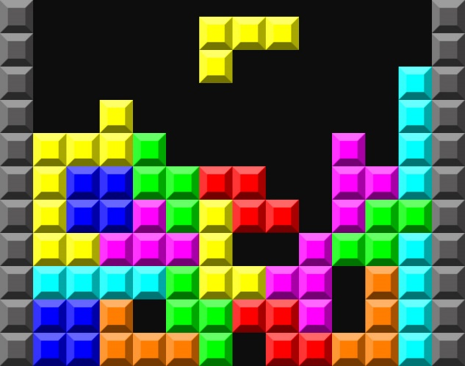
Design Theory: Randomness
“Dice Humped”
“Shuffle Bag”
Copyright Crowell Interactive Inc. ‹#›

Slide 36
Design Theory: Randomness
Dice operate on “INDEPENDENT probability” – they have no memory of the last roll, so the probability of getting a particular outcome on your next try is always the same.
Decks operate on “DEPENDENT probability” – once you’ve dealt a card, it’s not in the deck anymore, so the range of possible outcomes from the next deal is smaller.
Copyright Crowell Interactive Inc. ‹#›

Slide 37
DESIGN THEORY: COGNITIVE LOOP OF PLAY
Randomness is good ONLY HERE
Observe
Game State
Evaluate Did it work?
Plan
Choices!
Do
Execute the plan

Slide 38
Design Theory: Uncertainty & Risk
To engage players, a game needs to be uncertain.
No Risk
Comfortable Risk
Too Much Risk
No risk robs the choices of meaning.
Boring!
A good game allows a player to explore the choices, and find one that feels possible if they play well.
Satisfying!
If the player could lose too much, then the choice feels punitive and unfair.
Frustrating!
Copyright Crowell Interactive Inc. ‹#›

Slide 39
EMERGENT DESIGN: 1 + 1 = 3

Slide 40
ENVISION THE EXPERIENCE:
Explore and select ideas for what the player will experience as gameplay.
Short paragraphs describing examples of Challenges and progress through the Golden Path
“The Player faces a Challenge X. They know they can make Choices or do Actions A, B, or C.”

Slide 41
WORKSHOP SCHEDULE CREATE YOUR CONCEPT
Workshop Phases | Start Time | End Time | Minutes per | Activity
Meet n Greet | 10:00 | 10:10 | 10 | Meet each other while we wait for everyone to join
Overview | 10:10 | 10:20 | 10 | Workshop Roles and Goals Process Overview
Concept Lecture | 10:20 | 10:45 | 25 | Goals & Constraints Game Design Basics Envision the Experience
Concept: Create | 10:45 | 11:45 | 60 | Choose Curriculum Form Teams Choose Slice Envision Gameplay Finalize Concept
LUNCH | 11:45 | 12:45 | 60
Prototyping Lecture | 12:45 | 13:00 | 15
Prototyping: Create | 13:00 | 14:10 | 70 | Create Rules & Pieces Playtest & Iterate
Post Mortem | 14:10 | 14:40 | 30 | Assessment: Quick Share! Goals met? Process Ups and Downs?
Wrap Up | 14:40 | 14:50 | 10 | Other Resources Contact Info Q & A
End | 14:50 |  |  | All done!

Slide 42
CONCEPT: CREATE

Slide 43
CONCEPT DEV: OVERVIEW
Deliverable: A game concept with clear Goals and some game ideas that will achieve them.
Process:
Brainstorm fields of interest, form teams
ID Goals and Constraints
Focus on slice of Curriculum
Envision Gameplay
Document the Concept

Slide 44
CONCEPT DEV: CHOOSE CURRICULUM & FORM TEAMS:
Deliverable: Everyone on a team that is focused on a curriculum of their choice.
Process:
All: Brainstorm fields/curriculums of interest
You: Choose which field you want to work on
You: Sign up for the team who is working on that
You: Go to your Team sub-room in Zoom, start collaborating on your Team workspace.

Slide 45
CONCEPT DEV: GOALS AND CONSTRAINTS
Deliverable:
A statement of Goals and Constraints
Process
Discuss and fill in the Goals and Constraints sections of the Game Concept document

Slide 46
CONCEPT DEV: CHOOSE SLICE OF CURRICULUM
Deliverable:
1 Section that the game will focus on
The expected Learning Outcomes
Process: Identify a few different concepts and evaluate them
Ripe for game based approach: “It would be more interesting to DO than just read about it”
Relevance: How is it important to real life?
Are there usable systems associated with the concept?
Discuss real world actions that use them
Choose: the one that teaches best + sounds fun to play

Slide 47
CONCEPT DEV: ENVISION GAMEPLAY
Deliverable:
1 – 2 Actions that players will perform as the key gameplay
The Gameplay Flow (do this first, then this, then this)
Success and Fail conditions (1st Pass)
Process:
Complete the Core Game Design and Envision the Experience section of the Game Concept Document
Discuss Challenges that require the player to make choices based on their understanding the concepts.
Define the actions the player would do that use the concepts.
Show how player choices and actions can lead to winning or losing
Write the rules for performing, succeeding, and failing the actions.

Slide 48
CONCEPT DEV: FINAL CONCEPT
NOTE – creating and playtesting the prototype will almost certainly evolve the game. But it is essential to have a concept that COULD work as a starting point.
Deliverable:
Completed Concept
Process:
Clarify and write up the final Concept

Slide 49
BRAINSTORM THEMES & FORM GROUPS
Lets come up with 3-4 ideas
And form groups to create games centered on them
https://jamboard.google.com/d/1OrtjkVNw8qC_IvyIiLi5OjlP5uzmgK8mhvP-UFQd0LM/edit?usp=sharing
Notes:
https://jamboard.google.com/d/1OrtjkVNw8qC_IvyIiLi5OjlP5uzmgK8mhvP-UFQd0LM/edit?usp=sharing

Slide 50
CONCEPT: GO TO BREAKOUT ROOMS
Notes:
Grp1: https://docs.google.com/presentation/d/1HZo8379ESbO7afxRrJjYWOSARwhZtAGctv7HanywKik/edit?usp=sharing
Grp2: https://docs.google.com/presentation/d/1HZo8379ESbO7afxRrJjYWOSARwhZtAGctv7HanywKik/edit?usp=sharing
Grp3: https://docs.google.com/presentation/d/1yUI7jo2G65s-4zjczGhaaeiYN8X0wwvdEf0B8NzBMNw/edit?usp=sharing
Grp4: https://docs.google.com/presentation/d/1wC-dzQVBPeVjjkNlRnxTe6WwrGhMdNNH44f2bEkjbCo/edit?usp=sharing
Grp5: https://docs.google.com/presentation/d/1c3DczmEz-349tw9_oLJiEoUDFKhuo_cDSka6LYOROV0/edit?usp=sharing
Grp6: https://docs.google.com/presentation/d/1ihY6dXWEEXk3A9CljIUTTqknAPdgiM8TR2hrE1c6tcE/edit?usp=sharing

Slide 51
WORKSHOP SCHEDULE BREAK!
Workshop Phases | Start Time | End Time | Minutes per | Activity
Meet n Greet | 10:00 | 10:10 | 10 | Meet each other while we wait for everyone to join
Overview | 10:10 | 10:20 | 10 | Workshop Roles and Goals Process Overview
Concept Lecture | 10:20 | 10:45 | 25 | Goals & Constraints Game Design Basics Envision the Experience
Concept: Create | 10:45 | 11:45 | 60 | Choose Curriculum Form Teams Choose Slice Envision Gameplay Finalize Concept
LUNCH | 11:45 | 12:45 | 60
Prototyping Lecture | 12:45 | 13:00 | 15
Prototyping: Create | 13:00 | 14:10 | 70 | Create Rules & Pieces Playtest & Iterate
Post Mortem | 14:10 | 14:40 | 30 | Assessment: Quick Share! Goals met? Process Ups and Downs?
Wrap Up | 14:40 | 14:50 | 10 | Other Resources Contact Info Q & A
End | 14:50 |  |  | All done!

Slide 52
WORKSHOP SCHEDULE ON PROTOTYPING
Workshop Phases | Start Time | End Time | Minutes per | Activity
Meet n Greet | 10:00 | 10:10 | 10 | Meet each other while we wait for everyone to join
Overview | 10:10 | 10:20 | 10 | Workshop Roles and Goals Process Overview
Concept Lecture | 10:20 | 10:45 | 25 | Goals & Constraints Game Design Basics Envision the Experience
Concept: Create | 10:45 | 11:45 | 60 | Choose Curriculum Form Teams Choose Slice Envision Gameplay Finalize Concept
LUNCH | 11:45 | 12:45 | 60
Prototyping Lecture | 12:45 | 13:00 | 15
Prototyping: Create | 13:00 | 14:10 | 70 | Create Rules & Pieces Playtest & Iterate
Post Mortem | 14:10 | 14:40 | 30 | Assessment: Quick Share! Goals met? Process Ups and Downs?
Wrap Up | 14:40 | 14:50 | 10 | Other Resources Contact Info Q & A
End | 14:50 |  |  | All done!

Slide 53
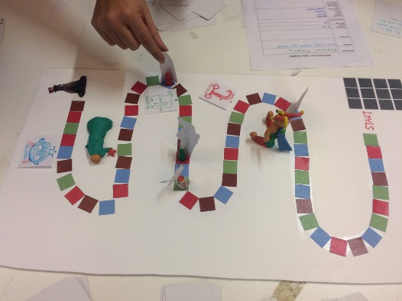
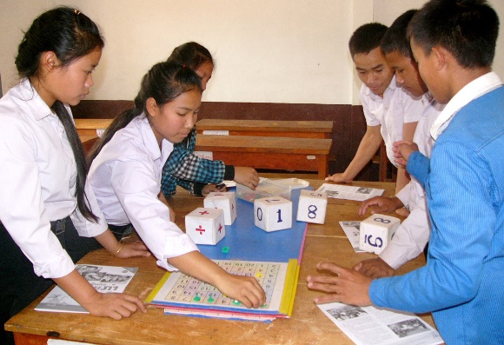
PROTOTYPE: LECTURE

Slide 54
WHAT IS A PROTOTYPE?
A prototype is a draft version of a product that allows you to explore your ideas and show the intention behind a feature or the overall design concept to users before investing time and money into development.
- https://www.usability.gov/how-to-and-tools/methods/prototyping.html

Slide 55
CONSIDERATIONS FOR THE DEVELOPMENT PHASE
Use the Concept as a guide
Gameplay should use the curriculum
Write it, try it, review and evolve it

Slide 56
PROTOTYPE: CREATE, PLAY, REVIEW, EVOLVE
Deliverable: Ugly Prototype that achieves the Goals.
Process: See chart 🡺
1: Create/Update
Create and Update the game pieces and rules
3: Review
Are Concepts being used as gameplay?
Pedagogy solid?
Meaningful choices?
Balance: Easy/Hard
What should be changed?
2: Playtest
Watch for Blockages
Increasingly depend on Rules exactly as written.
Update changes as needed.

Slide 57
WORKSHOP SCHEDULE CREATE PROTOTYPE
Workshop Phases | Start Time | End Time | Minutes per | Activity
Meet n Greet | 10:00 | 10:10 | 10 | Meet each other while we wait for everyone to join
Overview | 10:10 | 10:20 | 10 | Workshop Roles and Goals Process Overview
Concept Lecture | 10:20 | 10:45 | 25 | Goals & Constraints Game Design Basics Envision the Experience
Concept: Create | 10:45 | 11:45 | 60 | Choose Curriculum Form Teams Choose Slice Envision Gameplay Finalize Concept
LUNCH | 11:45 | 12:45 | 60
Prototyping Lecture | 12:45 | 13:00 | 15
Prototyping: Create | 13:00 | 14:10 | 70 | Create Rules & Pieces Playtest & Iterate
Post Mortem | 14:10 | 14:40 | 30 | Assessment: Quick Share! Goals met? Process Ups and Downs?
Wrap Up | 14:40 | 14:50 | 10 | Other Resources Contact Info Q & A
End | 14:50 |  |  | All done!
Copyright Crowell Interactive Inc.

Slide 58
ON PROTOTYPE DEV

Slide 59
PROTOTYPE DEVELOPMENT PHASE
Communicate & Collaborate
Use the tools
Evolve til it feels right

Slide 60
PROTOTYPE: CREATE, PLAY, REVIEW, EVOLVE
Deliverable: Ugly Prototype that achieves the Goals.
Process: See chart 🡺
1: Create/Update
Create and Update the game pieces and rules
3: Review
Are Concepts being used as gameplay?
Pedagogy solid?
Meaningful choices?
Balance: Easy/Hard
What should be changed?
2: Playtest
Watch for Blockages
Increasingly depend on Rules exactly as written.
Update changes as needed.

Slide 61
GO TO BREAKOUT ROOMS

Slide 62
WORKSHOP SCHEDULE PROJECT POSTMORTEMS
Workshop Phases | Start Time | End Time | Minutes per | Activity
Meet n Greet | 10:00 | 10:10 | 10 | Meet each other while we wait for everyone to join
Overview | 10:10 | 10:20 | 10 | Workshop Roles and Goals Process Overview
Concept Lecture | 10:20 | 10:45 | 25 | Goals & Constraints Game Design Basics Envision the Experience
Concept: Create | 10:45 | 11:45 | 60 | Choose Curriculum Form Teams Choose Slice Envision Gameplay Finalize Concept
LUNCH | 11:45 | 12:45 | 60
Prototyping Lecture | 12:45 | 13:00 | 15
Prototyping: Create | 13:00 | 14:10 | 70 | Create Rules & Pieces Playtest & Iterate
Postmortems | 14:10 | 14:40 | 30 | Assessment: Quick Share! Goals met? Process Ups and Downs?
Wrap Up | 14:40 | 14:50 | 10 | Other Resources Contact Info Q & A
End | 14:50 |  |  | All done!

Slide 63
POST MORTEM: Assess the project
Part 1 - Pitch:
Each team gives a SHORT Pitch presentation about their game
Intended Outcomes
Curriculum Concepts
Gameplay Description
Satisfaction with results
Part 2: Reflection:
Did we meet the Goals in:
Education?
Pedagogy?
Engagement?
What Went Right?
Next Time We Should…?

Slide 64
WORKSHOP SCHEDULE WORKSHOP SUMMARY
Workshop Phases | Start Time | End Time | Minutes per | Activity
Meet n Greet | 10:00 | 10:10 | 10 | Meet each other while we wait for everyone to join
Overview | 10:10 | 10:20 | 10 | Workshop Roles and Goals Process Overview
Concept Lecture | 10:20 | 10:45 | 25 | Goals & Constraints Game Design Basics Envision the Experience
Concept: Create | 10:45 | 11:45 | 60 | Choose Curriculum Form Teams Choose Slice Envision Gameplay Finalize Concept
LUNCH | 11:45 | 12:45 | 60
Prototyping Lecture | 12:45 | 13:00 | 15
Prototyping: Create | 13:00 | 14:10 | 70 | Create Rules & Pieces Playtest & Iterate
Post Mortem | 14:10 | 14:40 | 30 | Assessment: Quick Share! Goals met? Process Ups and Downs?
Wrap Up | 14:40 | 14:50 | 10 | Other Resources Contact Info Q & A
End | 14:50 |  |  | All done!

Slide 65
WORKSHOP POSTMORTEM: REGARDING THE PROCESS
The workshop was focused on a specific flavor of Game Based Learning game
But with tweaking, the process works for any game development project you want to conceptualize.

Slide 66
Q & A + RESOURCES
Time to ask final questions
Process: Ask Questions!
Chris Info
chris@crowellinteractive.ca
www.crowellinteractive.ca
www.linkedin.com/in/chriswombatcrowell
Some Other Resources:
Gamasutra Game Design
https://gamasutra.com/category/design/
Learning Games Network
learninggamesnetwork.org/
Game Jam Guide pdf
bit.ly/GJGuide
Teacher Pioneers pdf
press.etc.cmu.edu/index.php/product/teacher-pioneers/

Slide 67
WORKSHOP SCHEDULE
Workshop Phases | Start Time | End Time | Minutes per | Activity
Meet n Greet | 10:00 | 10:10 | 10 | Meet each other while we wait for everyone to join
Overview | 10:10 | 10:20 | 10 | Workshop Roles and Goals Process Overview
Concept Lecture | 10:20 | 10:45 | 25 | Goals & Constraints Game Design Basics Envision the Experience
Concept: Create | 10:45 | 11:45 | 60 | Choose Curriculum Form Teams Choose Slice Envision Gameplay Finalize Concept
LUNCH | 11:45 | 12:45 | 60
Prototyping Lecture | 12:45 | 13:00 | 15
Prototyping: Create | 13:00 | 14:10 | 70 | Create Rules & Pieces Playtest & Iterate
Post Mortem | 14:10 | 14:40 | 30 | Assessment: Quick Share! Goals met? Process Ups and Downs?
Wrap Up | 14:40 | 14:50 | 10 | Other Resources Contact Info Q & A
End | 14:50 |  |  | All done!

